Slide 1
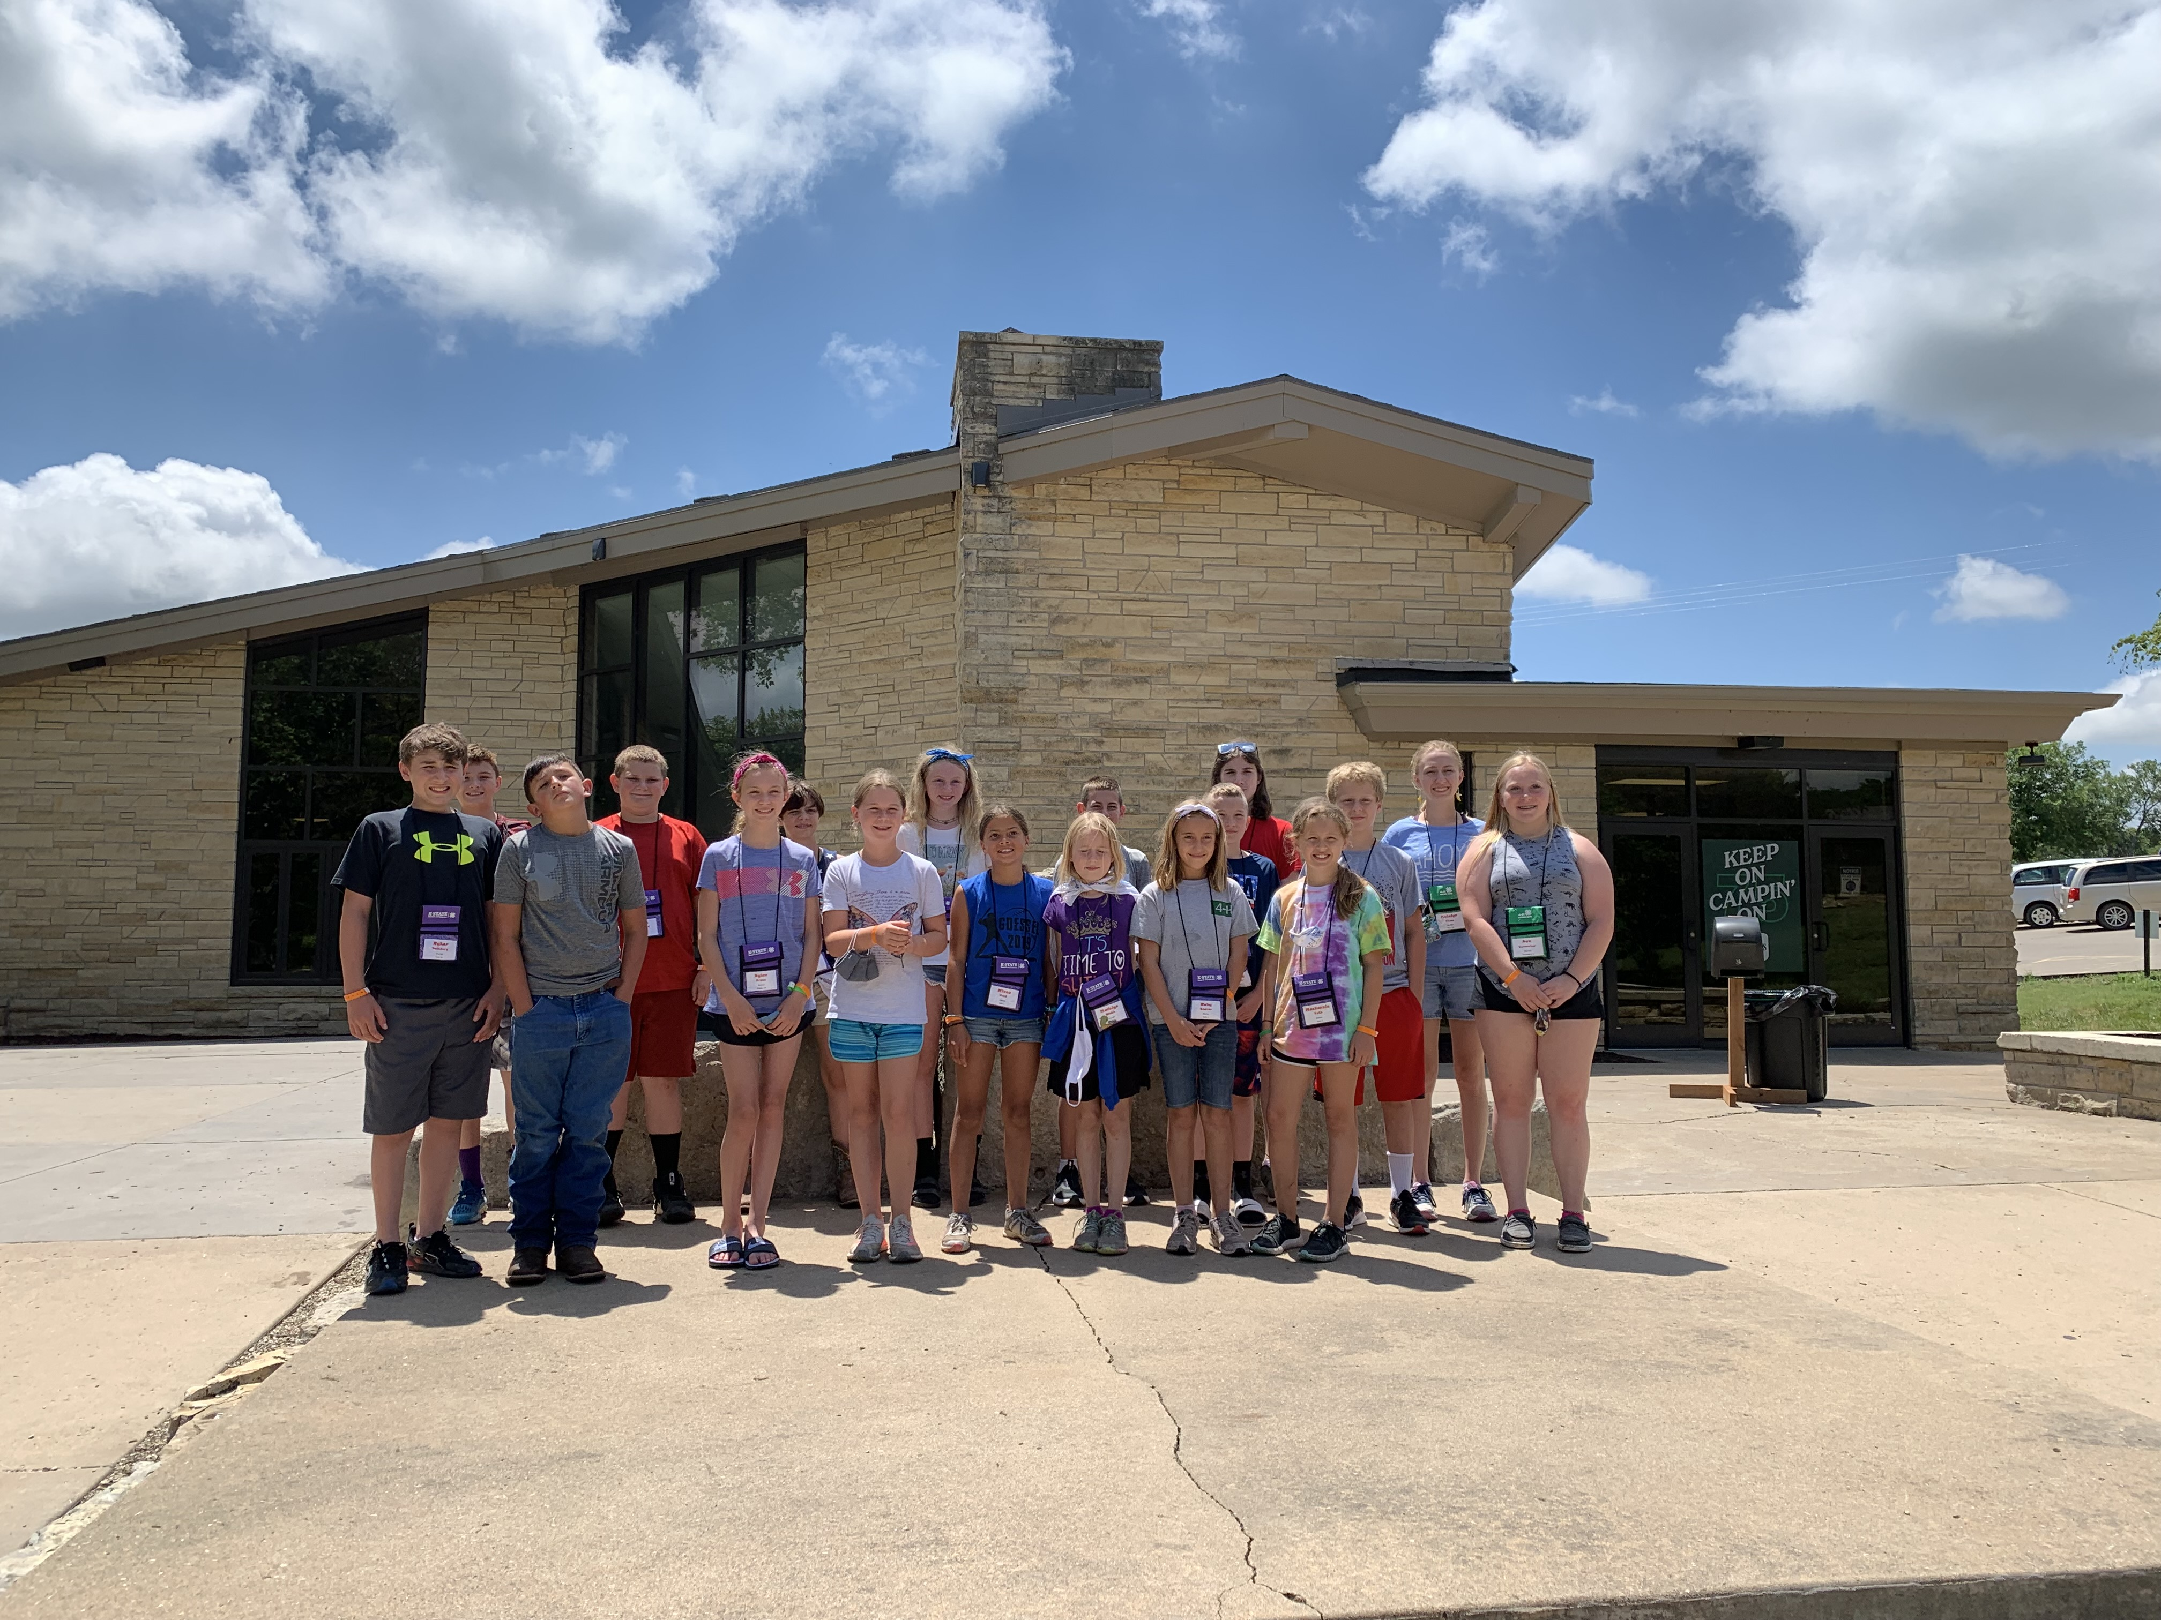
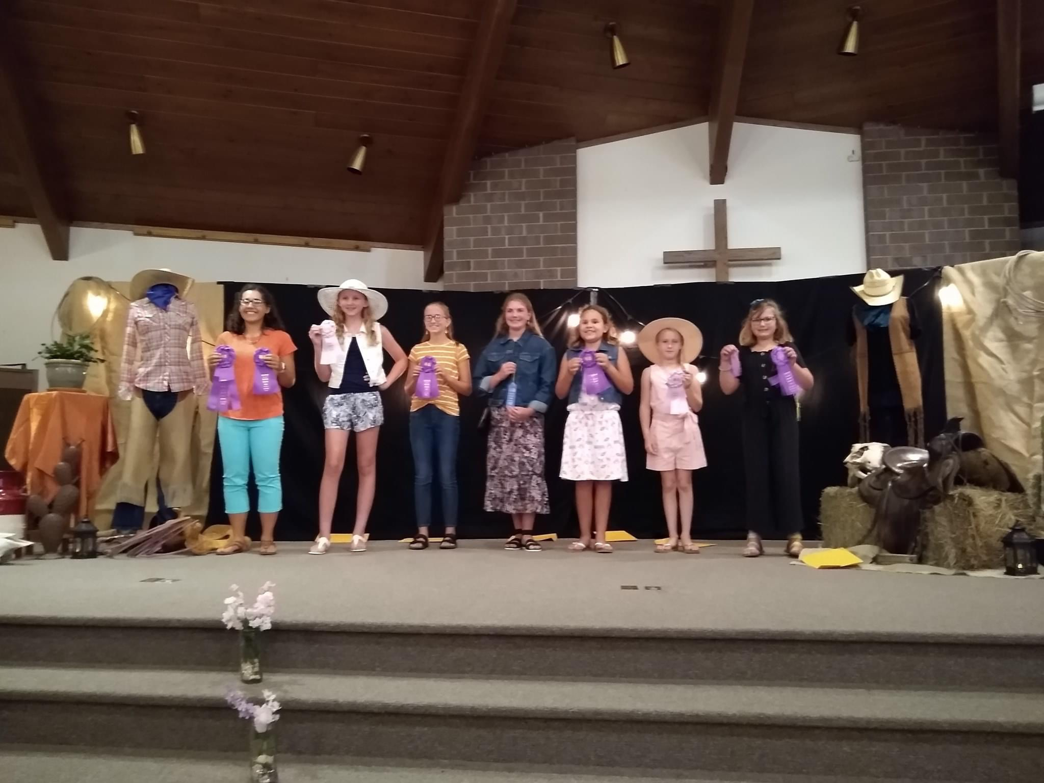
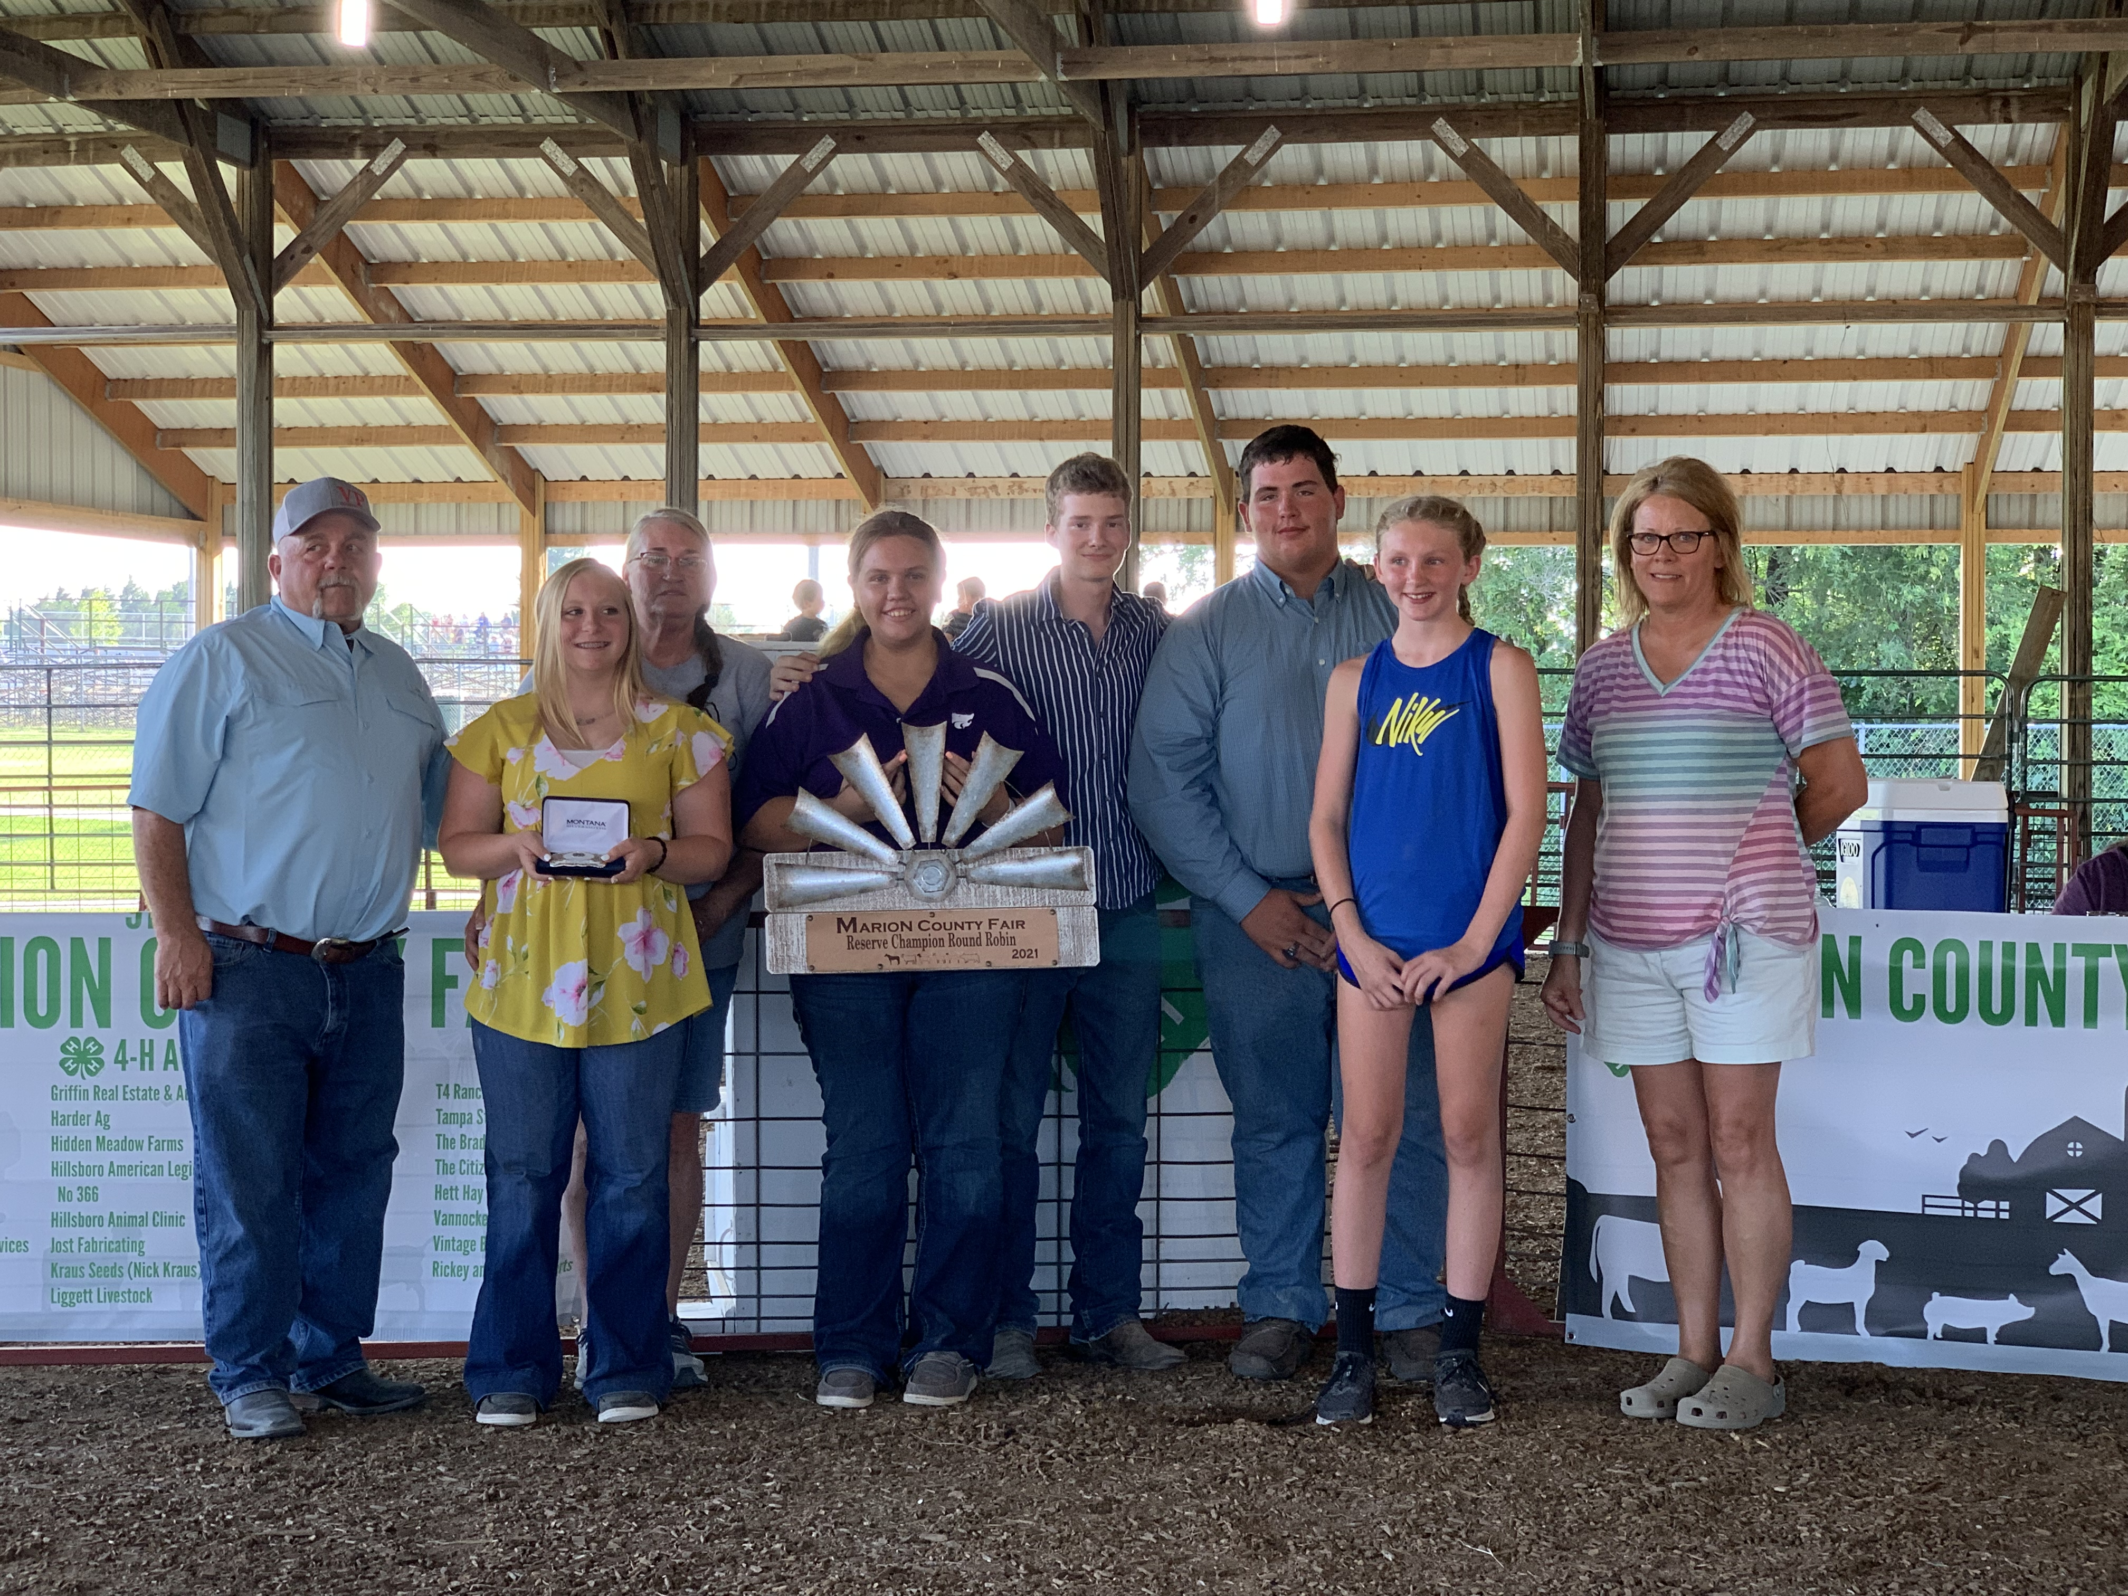
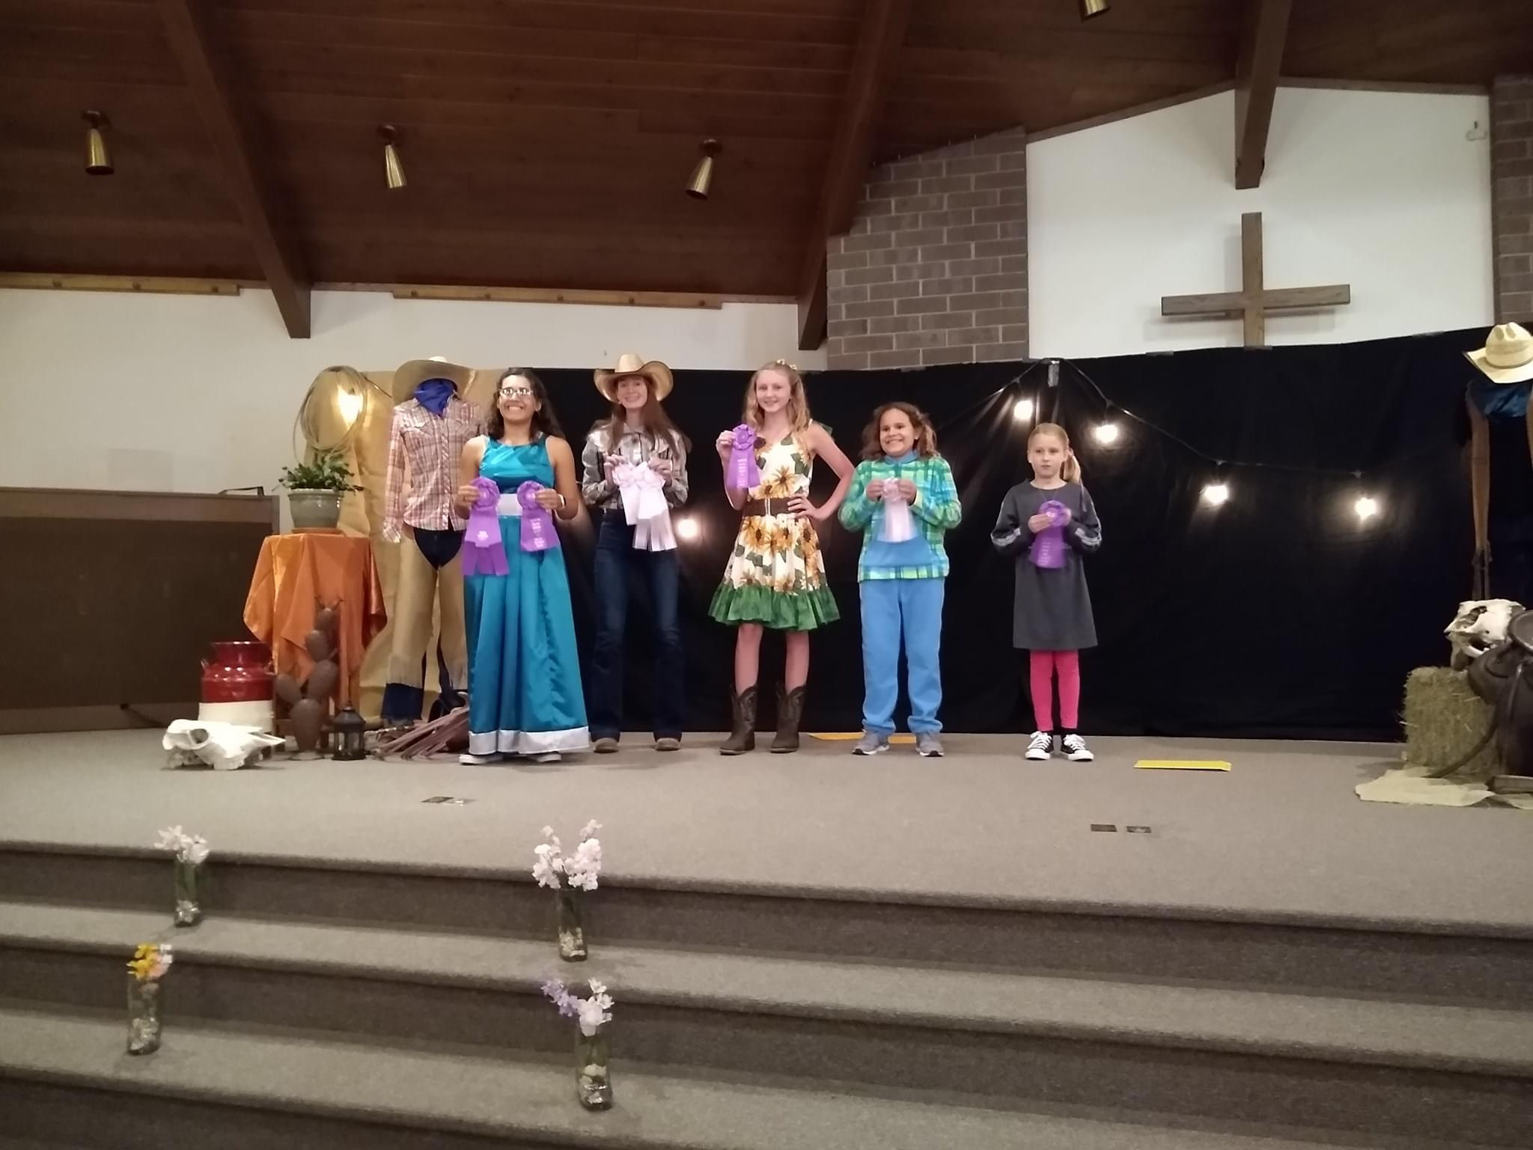
Marion County 4-H Council
October 10, 2021

Slide 2
Agenda
Call to Order
Pledge of Allegiance and 4-H Pledge
Roll Call
Minutes
Communications
Treasurers Report
Committee Reports
Sign-Up
Unfinished Business
New Business
Achievement Banquet
Approve 2021-2022 Calendar
4-H Enrollment
Financial Review Process
Election of Council Officers

Slide 3
Pledge of Allegiance and 4-H Pledge

Slide 4
Roll Call
What is your favorite 4-H Event?

Slide 5
Minutes
4-H Council May Meeting Minutes
The meeting of Marion County 4-H Council was held on Monday, May 24 at the Hillsboro City Building. Face-to-face attendance was optional and some council members joined via zoom.
The meeting was called to order by President Charlie Peters. The Pledges were recited and roll call was answered by 9 youth, 8 adults, and Extension Agents Tristen Cope and Rickey Roberts. Roll call was taken by verbally responding to the question “What is your favorite 4-H project?”
The March minutes were read by Secretary Karsen Kroupa. Minutes were approved as read with a motion to accept by Eli Boden and seconded by Karsen.
Communications: A state 4H publication featured a story and photographs of Happy Hustler members as part of the Kansas Beats the Virus CoVid-19 campaign.
The financial report was presented by Treasurer Olivia Carlson. 4H Council March 1, 2021 balance of $12,114.13. Income of $505 was received, which left the May 15, 2021 balance at $12,619.13. There were no expenses incurred during this time frame. The financial report was approved with a motion to accept by Ryleigh Jones and seconded by Noah Schmidt.

Slide 6
Minutes Cont’d…
Committee Reports were presented as follows:
Rickey Roberts updated the council members on the Spring Beef Show. It was well attended; over 100 head were shown. The day was considered a success! Rickey also updated the council on fair awards. A June 3 meeting will take place with the fair board and awards will be finalized. If anyone has ideas for awards or prizes they would like to see (something new and different) they should get these ideas to Rickey as soon as possible.
Rachel Boden, and 4H members enrolled in the clothing project, gave an update on the style revue. It will be held on Monday, July 19. Set-up will take place on Sunday afternoon. The theme will be western.
The Lazy Days Swine Show will be held and committee members will meet in August to finalize these plans.
Unfinished (Old) business was discussed as follows:
Masks are no longer required at 4-H events; however social distancing and proper handwashing is encouraged. As the fair approaches, be mindful of the judges and respect their wishes in regards to masks. All 4-H club leaders and members should be encouraging behaviors that reduce the spread of Co-Vid 19.
16 Campers and 2 Counselors have signed up for the Oz-Some 4-H Camp. Club leaders may contact the extension office for information regarding camps and/or campers and counselors.

Slide 7
Minutes Cont’d…
New Business was discussed as follows:
The Tri-County Free Fair will be held on Friday, July 9 - Sunday, July 11. All 4-H members in Marion County are welcome to participate. A schedule has been released and they are in need of Jr. Superintendents (if interested, please contact Tristen). Sign-up links will be posted on social media and extensions websites when they become available.
The Marion County Fair schedule will be released soon. The fairbook and website do include changes and some additional fair rules. Please review the STEM Project Section as Legos and Space Tech will now be considered STEM. Welding has also been added as a project and there are revisions to visual arts rules concerning copyright. Fair Entry begins on June 21 and runs through July 2. No late entries will be accepted.
The Marion County Fair is also in need of fair volunteers. Fair Superintendents and assistants are needed. Please contact Tristen if you are willing to assist with one of these positions.
Raffle Tickets to support the Marion County 4-H Endowment Fund will be given to club leaders. This is a fundraiser that supports local 4-H events, scholarships, projects, etc. It is important that each club participates in this raffle and sells the allotted number of tickets.
Fair Set-Up will take place on Saturday, July 17. It will begin at 8:00 a.m. Fair Clean-Up and Project Release will be on Saturday, July 24. See the fair schedule for more information. If you are unable to help with set-up and clean-up, please make appropriate arrangements with the extension office.

Slide 8
Minutes Cont’d…
After discussion, it was decided that an optional livestock check-out will be added on Friday evening, July 23. Another change is the Commissioner’s Gift Basket. The judging of Commissioner’s Gift Baskets will take place during Visual Arts on Wednesday, July 21; however, one 4-H member from each of the following clubs: Peabody, Tampa, Lincolnville, South Cottonwood, and Happy Hustlers will need to be present at the August 2nd County Commission Meeting. A presentation to the commissioners will be made at that time.
Discussion about the Friends of 4H events and Project Auction was held. There will be a transition away from the pulled-pork meal and it was decided that pie and ice cream will be served. In the past, it has been difficult to find volunteers to help with the meal and with unknown attendance after Co-Vid the council was looking for a way to “restart” this event but minimize the cost and work force. Clubs will be asked to provide pies and the ice cream will come from KSU’s Call Hall. The purpose of this event is to thank buyers and supporters of 4H and a “thank-you policy” was also discussed. The council is moving forward with the pie and ice cream idea and will be reevaluating the event and an addition of a “thank you policy” after the fair is held. Club leaders should reinforce that THANKING BUYERS AND SUPPORTERS OF 4-H IS AN EXPECTATION FOR THOSE PARTICIPATING IN THE PROJECT AUCTION OR THOSE THAT ARE BENEFICIARIES OF ANY TYPE OF SPONSORED ACTIVITY!
Volunteers will be needed for the following events during the fair and sign-up will be done through fair entry: Community Hot Dog Feed, MCFA Food Stand, and 4-H Food Stand Fundraiser in cooperation with Lions Club (new).
The next 4-H Council meeting is TBA.
A motion to adjourn the meeting was made by Noah and seconded by Michelle Hajek.
Minutes taken by: Karsen Kroupa

Slide 9
Communications

Slide 10
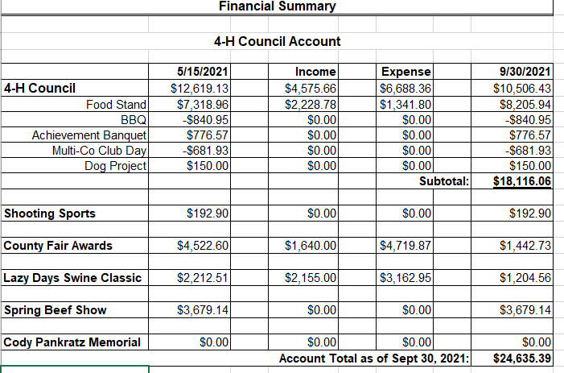
Treasurer’s Report

Slide 11
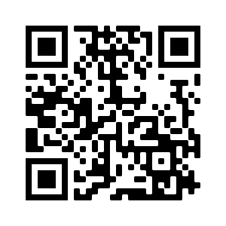
Committee Reports
Please fill out the 4-H Council Contact Sheet and Committee at the following link: https://forms.gle/4HfmE8az6H9h6Jd4A OR by opening your camera and following the link from the QR Code.

Slide 12
Old Business

Slide 13
New Business
Achievement Night
Monday, November 8th at 6:30 PM
Marion County Lake Hall
Theme/Decorations: Happy Hustlers 4-H Club
Dinner: Extension Office will provide meat, paper ware, drinks
Families: Provide a side dish
Presentation: Slide Show??

Slide 14
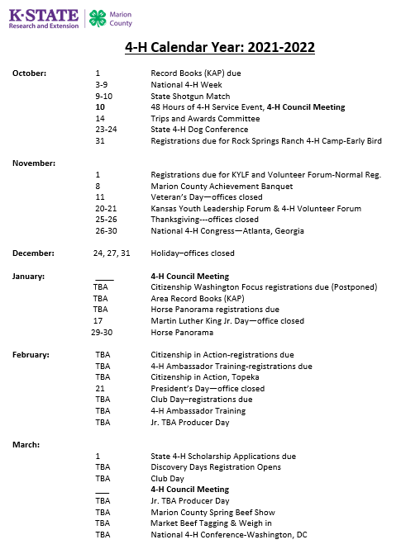
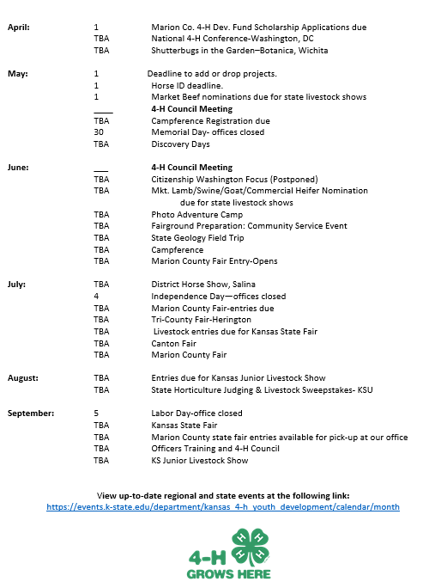
New Business
Approve 2021-2022 4-H Calendar

Slide 15
New Business
4-H Enrollment
Discounted Fee: Oct.1-Dec. 1st
Fee will be $15 (unless new family) after Dec.1st
Enroll: https://v2.4honline.com
Re-enrollment steps: https://www.kansas4-h.org/resources/4-h-onlinefamily-resources/index.html
Video Tutorial of 4H Online: https://youtu.be/r-Ajj1B_c7s
Coupon Code: This year the “sponsorship” is referred to as a coupon code.
The Coupon Code is: BOMKWN
The program fee should reduce to a $0.00 balance. Be sure to click SUBMIT after verifying your club and projects.
The $15.00 Kansas 4-H Program Fee is being covered by the following:
$5.00 Marion County 4-H Endowment Fund
$5.00 Marion County 4-H Council
Please ask your Club Leaders about the remaining $5.00
Don’t forget to use Google Chrome as your browser for the system to work correctly.

Slide 16
New Business
Financial Review Process
Due to Office Nov. 1st
PDF on Chisholm Trail Extension District Webpage: https://www.chisholmtrail.k-state.edu/4_h/volunteers/Volunteers.html

Slide 17
New Business
Election of 4-H Council Officers
President: Ashley Peters
Vice President: Charlie Peters
Secretary: Karsen Kroupa
Treasurer: Noah Schmidt

Slide 18
Adjourn
Next Meeting Date: January 16, 2022

