Slide 1
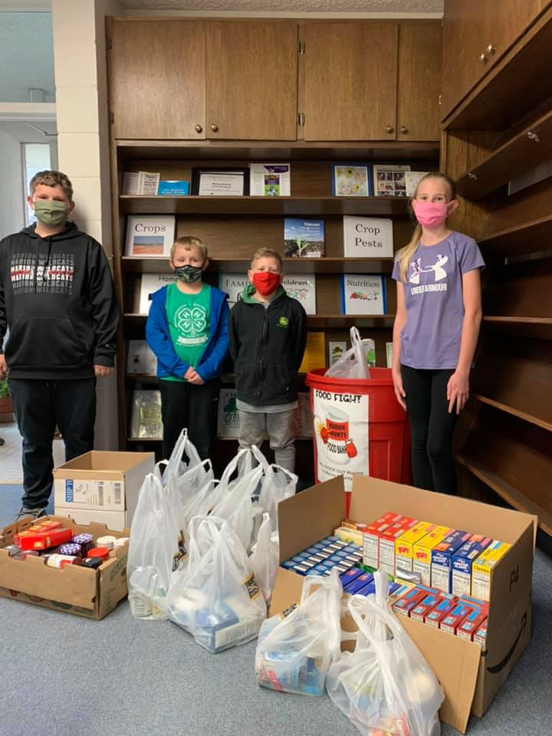
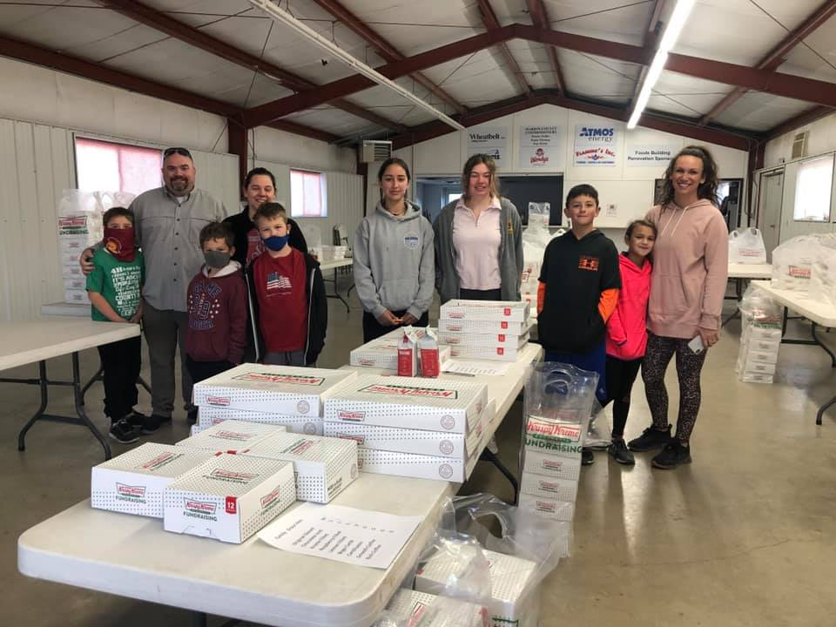
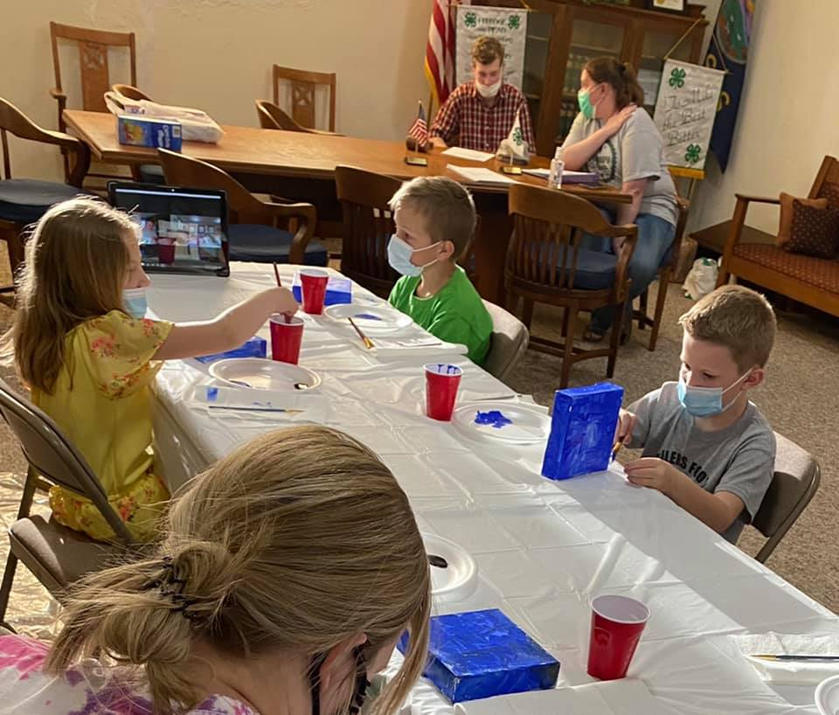
Marion County 4-H Council
May 24, 2021

Slide 2
Agenda
Call to Order
Pledge of Allegiance and 4-H Pledge
Roll Call
Minutes
Communications
Treasurers Report
Committee Reports
Unfinished Business
COVID Protocol Modification
Oz-Some 4-H Camp
New Business
Tri-County Free Fair
Marion County Fair
Fair Entry
Fair Superintendent and Assistants
Commissioners Gift Baskets
4H Concessions & Arena Fundraiser
Volunteers Needed for Fair Events
Friends of 4-H Event and Project/Livestock Auction
4-H Endowment Fund Raffle Tickets

Slide 3
Pledge of Allegiance and 4-H Pledge

Slide 4
Roll Call
What is your favorite Fair memory?

Slide 5
Minutes
4-H Council Meeting Minutes: May
The Marion County 4-H Council was held on March 8, 2021. via Zoom.
The meeting was called to order by President Charlie Peters. The Pledges were recited and roll call was answered by 8 Youth, 10 Adults, and Extension Agents Tristen Cope and Rickey Roberts. Roll Call was taken by verbally responding to the question “What is something you can cook best?”
The January Minutes were read by Secretary Karsen Kroupa. Minutes were approved as read with a motion to accept by Karsen and seconded by Noah Schmidt.
Communications: There were no communications shared during the meeting.
The financial report was presented by Treasurer Olivia Carlson. 4H Council ended 2020 with a balance of $12664.13. There were expenses of $550, which left the beginning balance for March 1, 2021 at $12114.13. The financial report was approved with a motion to accept by Karsen and a second by Jennifer Gaines.
Committee Reports were presented as follows:
Rickey Roberts updated the council members on the Spring Beef Show. It is to be held on Sunday, March 28 at the Marion County Fairgrounds. This show is open to all 4-H and FFA members and award cash prizes. Fair awards were also briefly discussed.
Ryleigh and Michele Hajek shared that the Marion County Fair Board continues to seek sponsors for the Marion County Fair. A list of sponsors will be shared so that 4H members can properly extend their gratitude.

Slide 6
Minutes Cont’d…
Old Business:
Multi-County Club Day: The Multicounty Club Day will be a virtual event and videos can be submitted through Flip Grid. 4Hers will take a video of their presentation and submit it to be judged. Submissions begin on March 8 and end on March 22 at midnight. Judging will take place from March 23 - March 31. There will also be several judging contests that 4Hers can participate in.
New Business:
The Chisholm Trail 4-H District is excited to announce that Face-To-Face meetings can begin! Clubs are encouraged to use a hybrid model to give families the option to attend in-person or virtually. The Chisholm Trail 4-H District also encourages that all Co-Vid 19 safety measures are observed, such as proper social distancing, masks, hand-washing, etc. should be considered as clubs reinstate F2F activities.
Scholarship deadlines are quickly approaching.
The Kansas Youth Leadership Forum will be held in November and the application is October 10. This is open to 4H youth, ages 14-19.
The 4H Endowment scholarship application is due on April 1. This is open to Marion County 4H members who meet certain criteria and offers a total a $1,000 in scholarship opportunities.
There are also many 4H scholarships available at the state level. A link was shared for this scholarship application.

Slide 7
Minutes Cont’d…
4-H Camp will be held on June 24-27. A Purple Power Pack Camp is also an option, it is being held on June 18-21. A selection process may be needed to determine the 4H members that will attend camp; this is due to Co-Vid 19 protocols that are limiting participation. Counselors are needed and would report to camp on June 23.
4-H Council has been given the opportunity to participate in the Lion’s Club Fundraiser during the Marion County Fair. This will be on Friday and Saturday evenings from 5 – 10 p.m. There would need to be 4 youth, 2 adults, and 1 grill master for each shift and 2 shifts will be needed each night. The first shift will run from 5 – 8 p.m and the second shift will be from 8 – 10 p.m. The Lion’s Club will purchase all food and necessary supplies. The Lions Club will retain 10% of the gross income plus enough to cover expenses, with the remainder of the income going to council. This fundraiser will be located at the Arena.
4H will also have concessions in the food building during the Marion County Fair. Concessions will be on Wednesday, Thursday, and Friday from 10 a.m. – 4 p.m. There will be two shifts each day, from 10 a.m. – 1 p.m. and from 1 – 4 p.m. There will need to be 3 youth and 2 adults on each shift. Items will need to be donated by 4H clubs to assist in the fundraiser.
The fundraising from the 2021 Marion County Fair will help support renovations taking place in 4H Building, which will make a nicer facility for Marion County 4H members, their families, and our communities.
The next 4-H Council Meeting will take place on May 10 using the hybrid model.
Adjournment: A motion was moved and seconded to adjourn the meeting. The names of those who made these motions was not recorded.
-Minutes Taken By: Karsen Kroupa

Slide 8
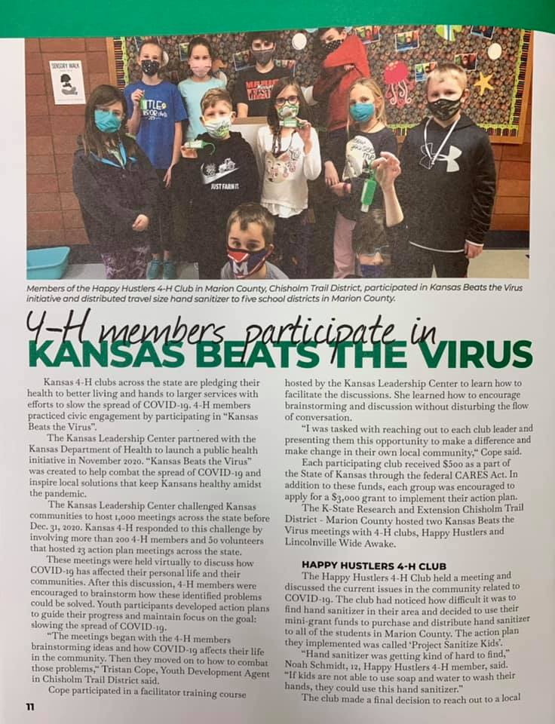
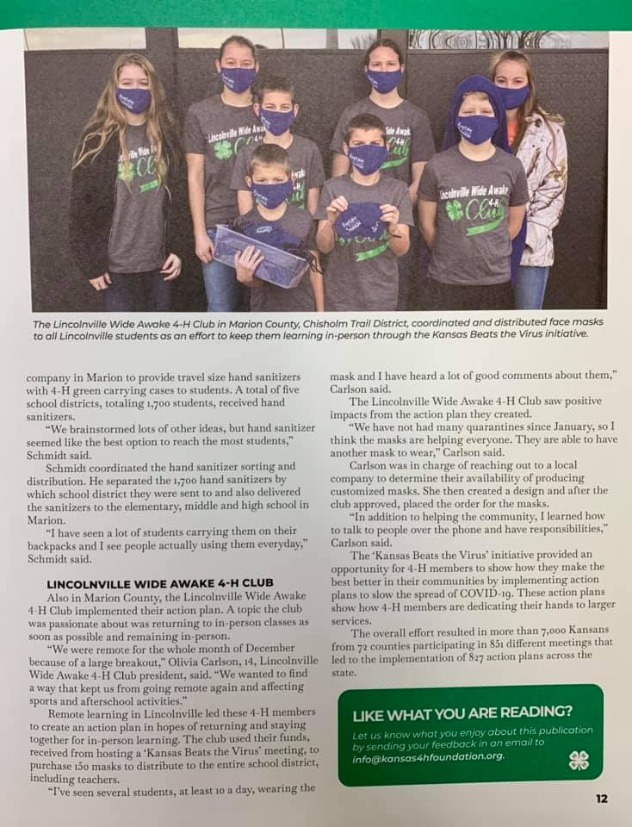
Communications

Slide 9
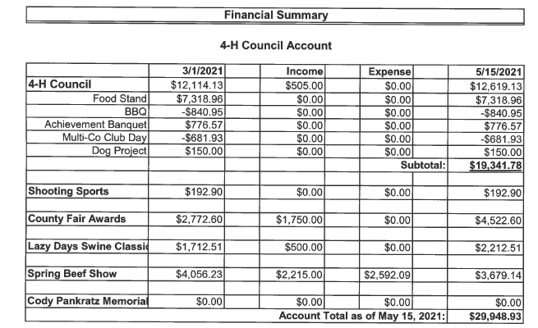
Treasurer’s Report

Slide 10
Committee Reports
Spring Beef Show
Fair Awards
Style Revue Committee
Lazy Days Swine Show

Slide 11
Old Business
COVID Protocol Modifications: Masks are no longer required, but now encouraged. Please continue to follow social distancing, hand washing, ect.

Slide 12
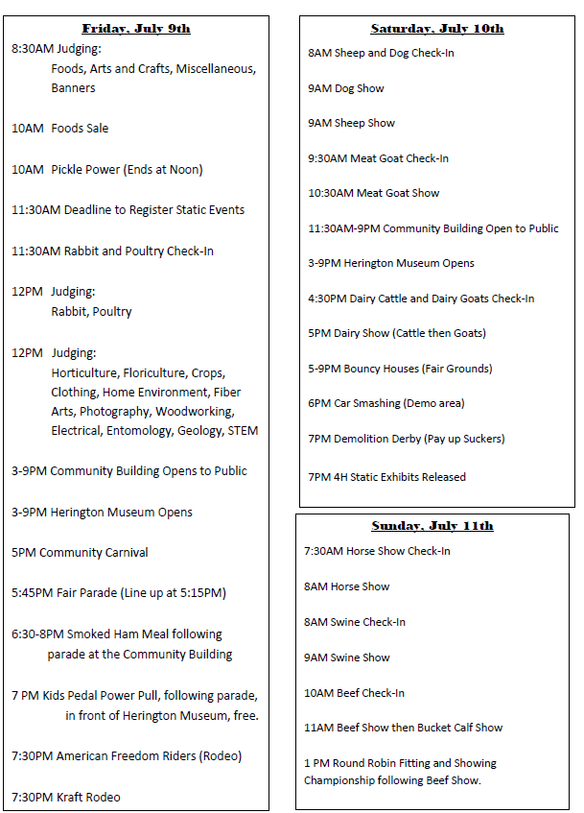
New Business

Slide 13
New Business
Marion County Fair Book--Updated
Fair Entry: June 21st 12:01 AM through July 2nd 11:59 PM
Superintendent/Assistant Sign-Up
Commissioners Gift Baskets (Judging on Wednesday)
Peabody Achievers
Tampa Triple T’s
South Cottonwood
Lincolnville Wide Awake
Happy Hustlers
4-H Concession Stand/Food Stand Fundraiser (See handout)
4-H Volunteers Needed (See handout)

Slide 14
New Business
Friends of 4-H Event and Livestock Project Auction
Survey Results

Slide 15
New Business
4-H Endowment Fund Raffle Tickets
Hog Raffle
KSU Ticket Raffle

Slide 16
New Business
4-H Council Fundraiser at Arena
Days: Friday, Saturday
Hours: 5 PM to 10 PM
Shifts: 5-8, 8-10
Support/Shift: 4 Youth, 2 Adults, 1 Grill Master
Food:
Hot Dogs
Hamburgers
Nachos
Chips
Candy Bars
Popcorn
Drinks: Pop, Water, Poweraid
Frozen Drinks
Equipment:
Hot Dog Warmer
Nacho Dispenser
Frozen Drink Machine
Details:
Lions Club will purchase the food initially and will be taken out of expenses.
10% gross income to Lions Club
Typically $1,000-1,500 @ Derby

Slide 17
New Business
Foods Building Concessions for 4-H Building Renovation
Days: Wednesday, Thursday, Friday
Hours: 10 AM to 4 PM
Shifts: 10-1, 1-4
Support/Shift: 3 Youth, 2 Adults
Food:
Hot Dogs
Nachos
Chips
Candy Bars
Drinks: Pop, Water, Poweraid
Frozen Drinks
Equipment:
Hot Dog Warmer
Nacho Dispenser
Frozen Drink Machine
Question:
Donation Items/$

Slide 18
New Business
Foods Building Concessions
Days: Wednesday, Thursday, Friday
Hours: 10 AM to 4 PM
Shifts: 10-1, 1-4
Support/Shift: 3 Youth, 2 Adults
Food:
Hot Dogs
Nachos
Chips
Candy Bars
Drinks: Pop, Water, Poweraid
Frozen Drinks
Equipment:
Hot Dog Warmer
Nacho Dispenser
Frozen Drink Machine
Question:
Donation Items/$
Arena 4-H Council Fundraiser
Days: Friday, Saturday
Hours: 5 PM to 10 PM
Shifts: 5-8, 8-10
Support/Shift: 4 Youth, 2 Adults, 1 Grill Master
Food:
Hot Dogs
Hamburgers
Nachos
Chips
Candy Bars
Popcorn
Drinks: Pop, Water, Poweraid
Frozen Drinks
Equipment:
Hot Dog Warmer
Nacho Dispenser
Frozen Drink Machine
Details:
10% gross income to Lions Club
Typically $1,000-1,500 @ Derby
Lions Club provides equipment and food needed. The food will be taken out of profit.

Slide 19
Adjourn
Next Meeting Date: TBA

