Slide 1
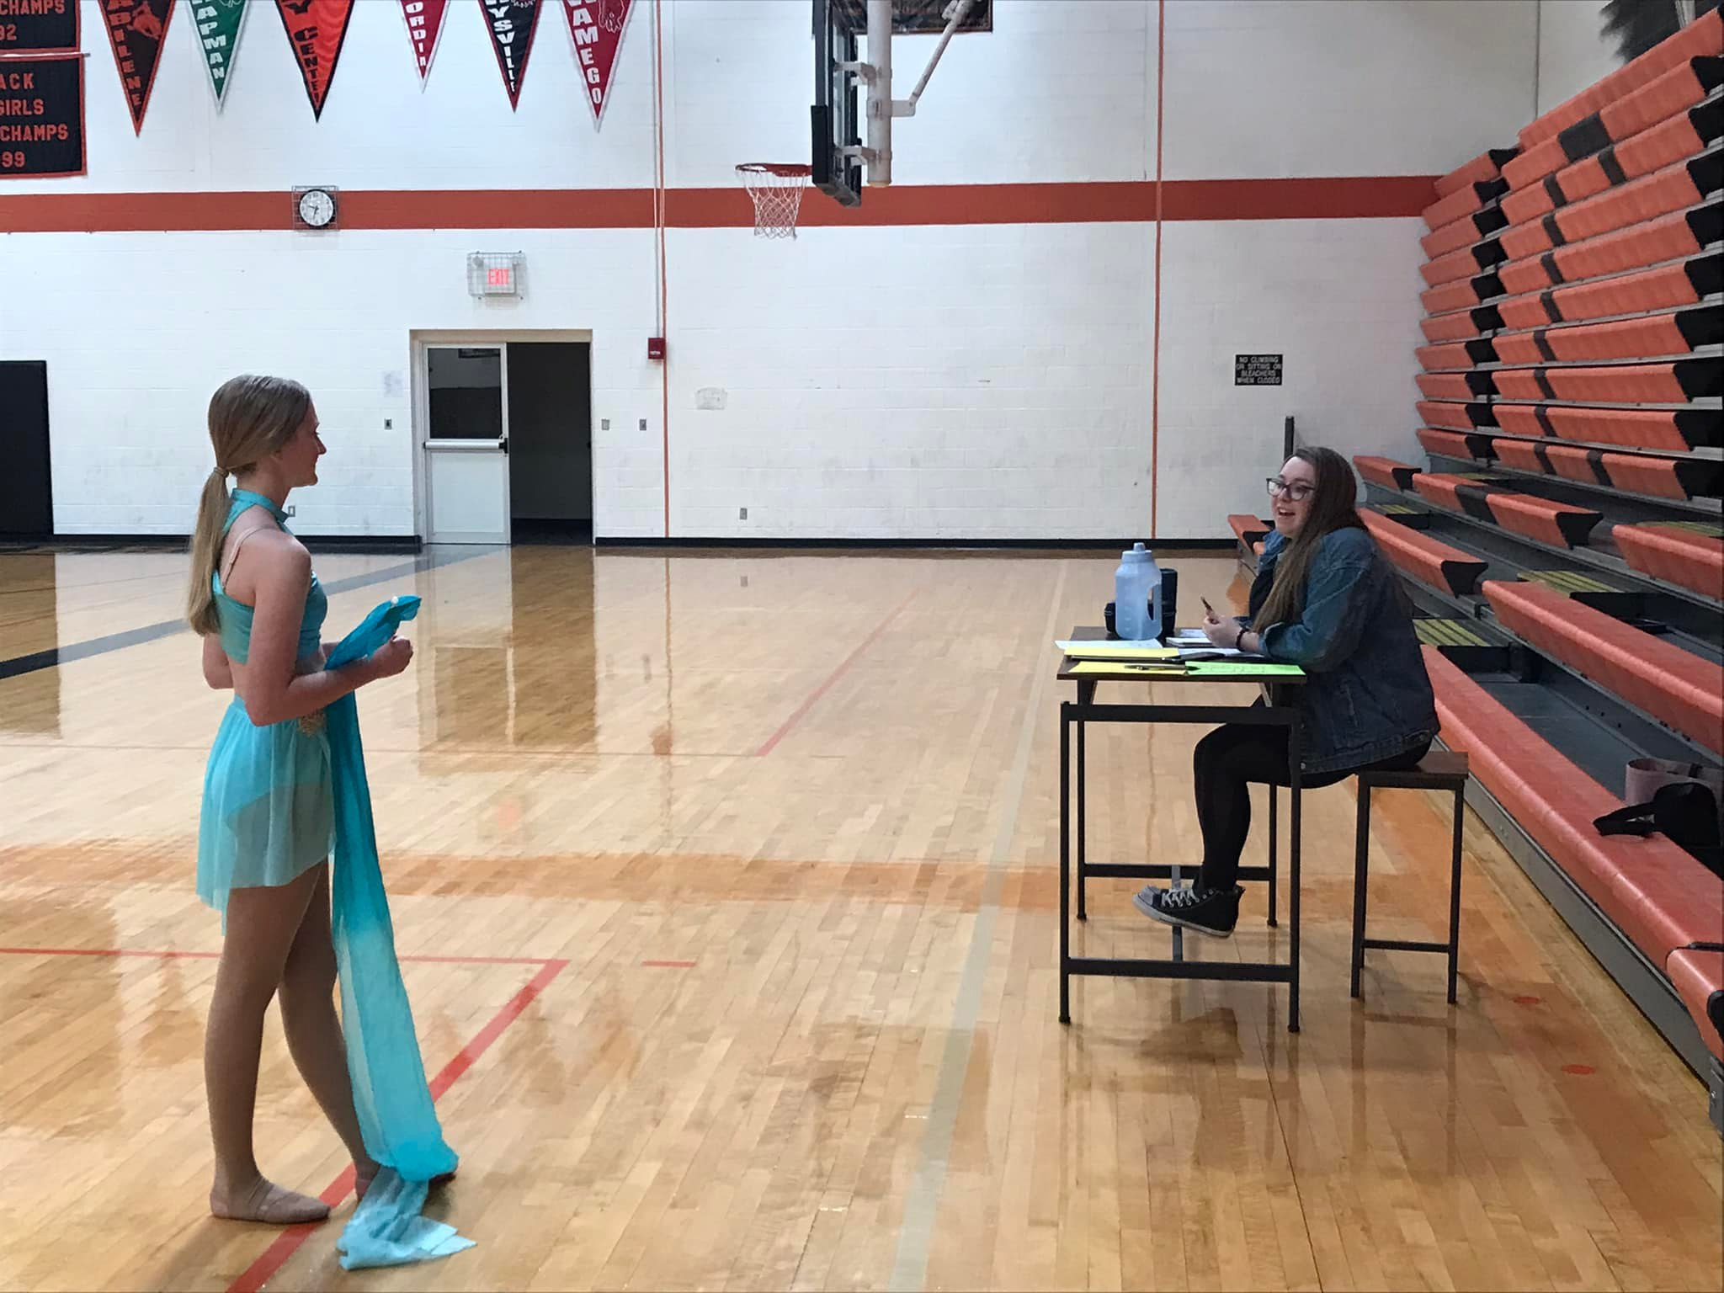
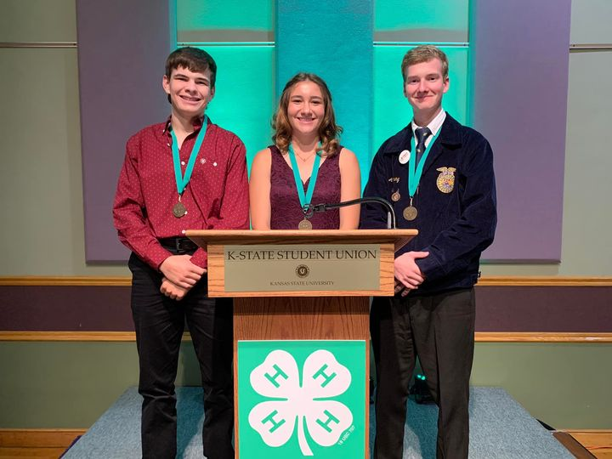
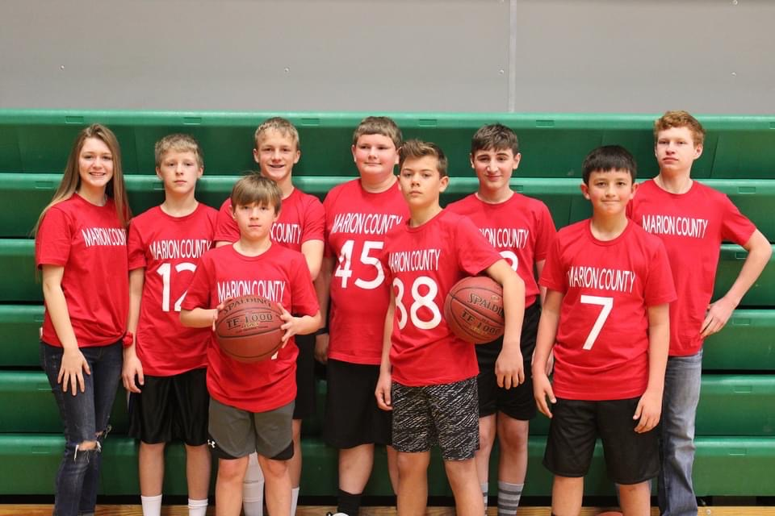
Marion County 4-H Council
March 23, 2023

Slide 2
Agenda
Call to Order
Pledge of Allegiance and 4-H Pledge
Roll Call
Minutes
Communications/Club Reports
Treasurers Report
Committee Reports
Spring Beef Show
Fair Awards
Style Revue
Old Business
4-H Council Sponsorship Drive
Food Stand
Friends of 4H Meal
PA System
New Business
Fair Schedule
Upcoming Events

Slide 3
Pledge of Allegiance and 4-H Pledge

Slide 4
Roll Call
What do you wish others would know about 4-H?

Slide 5
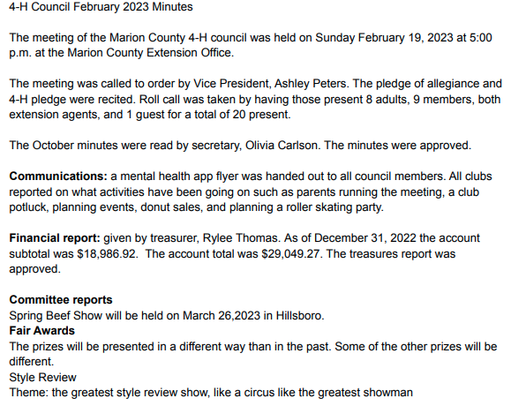
Minutes
4-H Council February Meeting Minutes

Slide 6
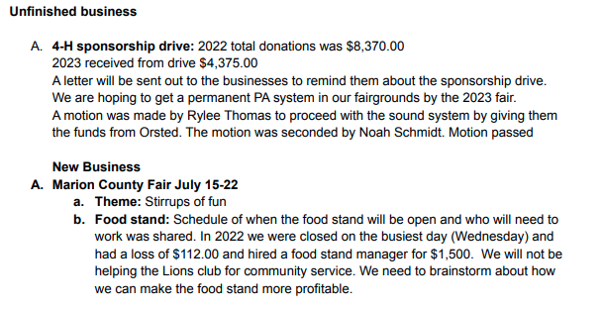
Minutes Cont’d…

Slide 7
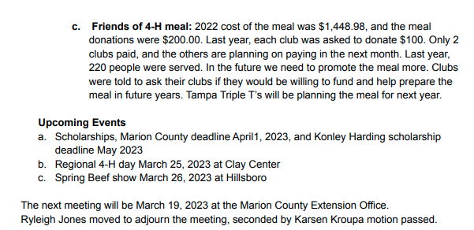
Minutes Cont’d…

Slide 8
Communications
Club Report Out!!
What is something your enjoy about your Club Meetings?
Notes:
Lindsey is a 10-year member of the Willowdale Club in Dickinson County, which is now part of the Chisholm Trail District. Lindsey has been selected as a Kansas Representative for National 4H Congress and is seeking donations to assist with the expenses of the trip.

Slide 9
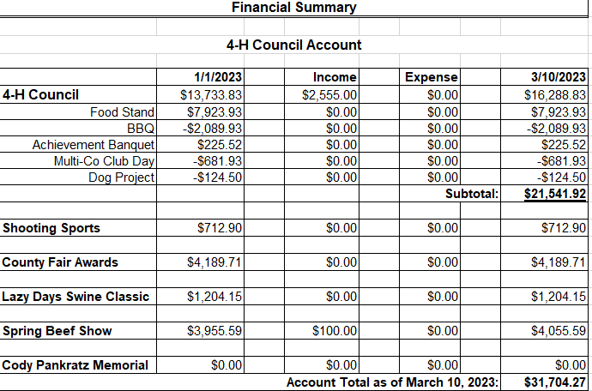
Treasurer’s Report

Slide 10
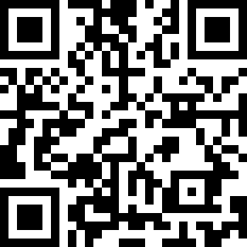
Committee Reports
Spring Beef Show
Fair Awards
Style Revue
Lazy Days Swine Show
Sign Up: https://tinyurl.com/MN4HCommittee

Slide 11
Unfinished Business
4H Council Sponsorship Drive
2022 Total Donations for All Events (Spring Beef Show, Fair Awards, Lazy Days Swine Show): $8,370.00
2023 Received from Drive: $5,600.00

Slide 12
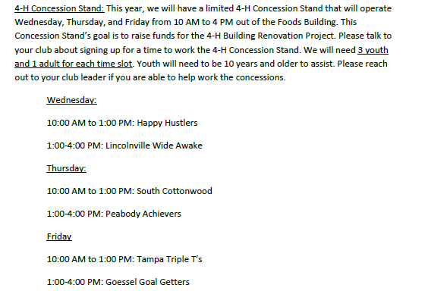
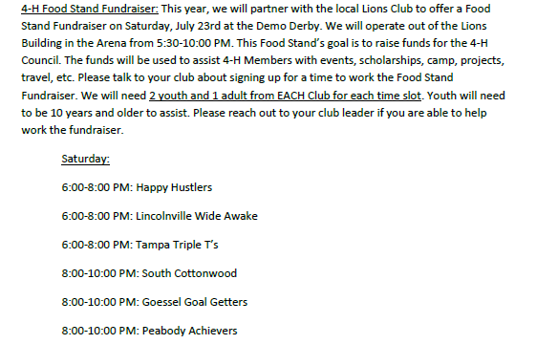
Unfinished Business
Marion County Fair: Food Stand 2022
*Was Closed Wed.

Slide 13
Unfinished Business
Marion County Fair: Food Stand 2022
2022: Loss of $112.10 and District cost of $1,500 for Food Stand Manager
2023: District cost of $1,500 for Food Stand Manager
2022 Food Stand Schedule
Wed from 5-9 PM
Will assist Lions Club but need donation
2024: Absorb Cost of $1,500 for Food Stand Manager

Slide 14
Unfinished Business
Friends of 4-H Meal
2022 Cost $1,448.98
2022 Meal Donations: $200.00
2023
Meal/Host: Tampa Triple T’s
Discussion: Purpose and Sustainability of Meal
2023 VOTE
Clubs donate $100 for meal each year

Slide 15
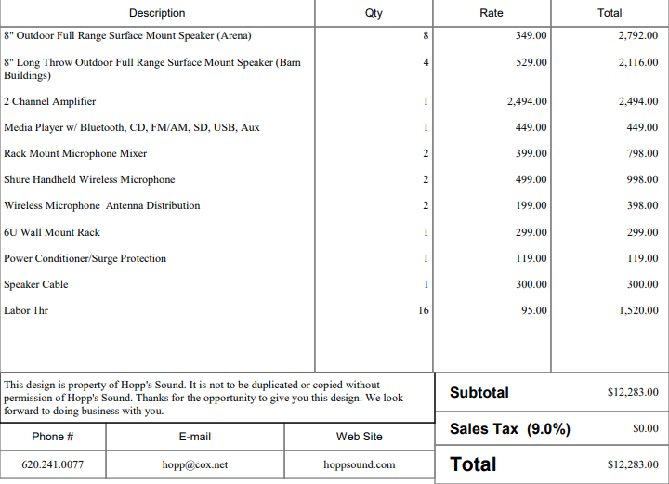
Unfinished Business
Fairgrounds PA System
Quote

Slide 16
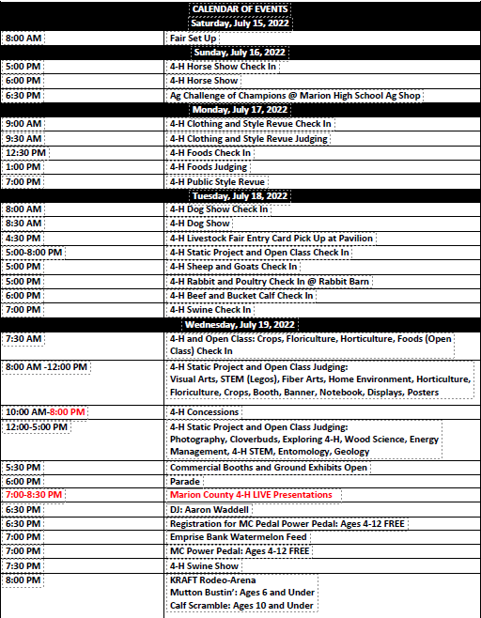
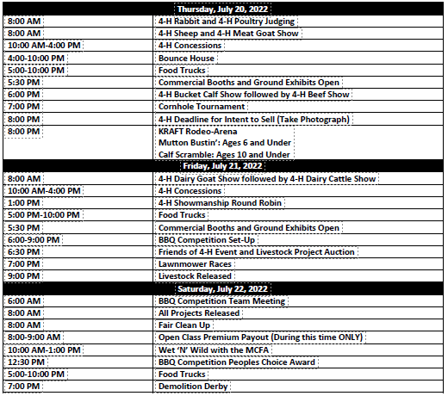
New Business
DRAFT Marion County Fair Schedule

Slide 17
Upcoming events
District Officer Training:
Marion County Deadline: April 1, 2023
https://www.chisholmtrail.k-state.edu/4_h/forms_and_applications/marion_forms_apps/index.html
Konley Harding Scholarship Deadline: May 2023
https://www.flinthills.k-state.edu/4-h/morris-county/scholarships/documents/Timeless%20Application%20Konley%20Harding%20PDF.pdf
Regional 4-H Day:
Date: March 25, 2023 at Clay Center
Spring Beef Show:
Date: March 26, 2023

Slide 18
Adjourn
Next Meeting Date: May 8, 2023

