Slide 1
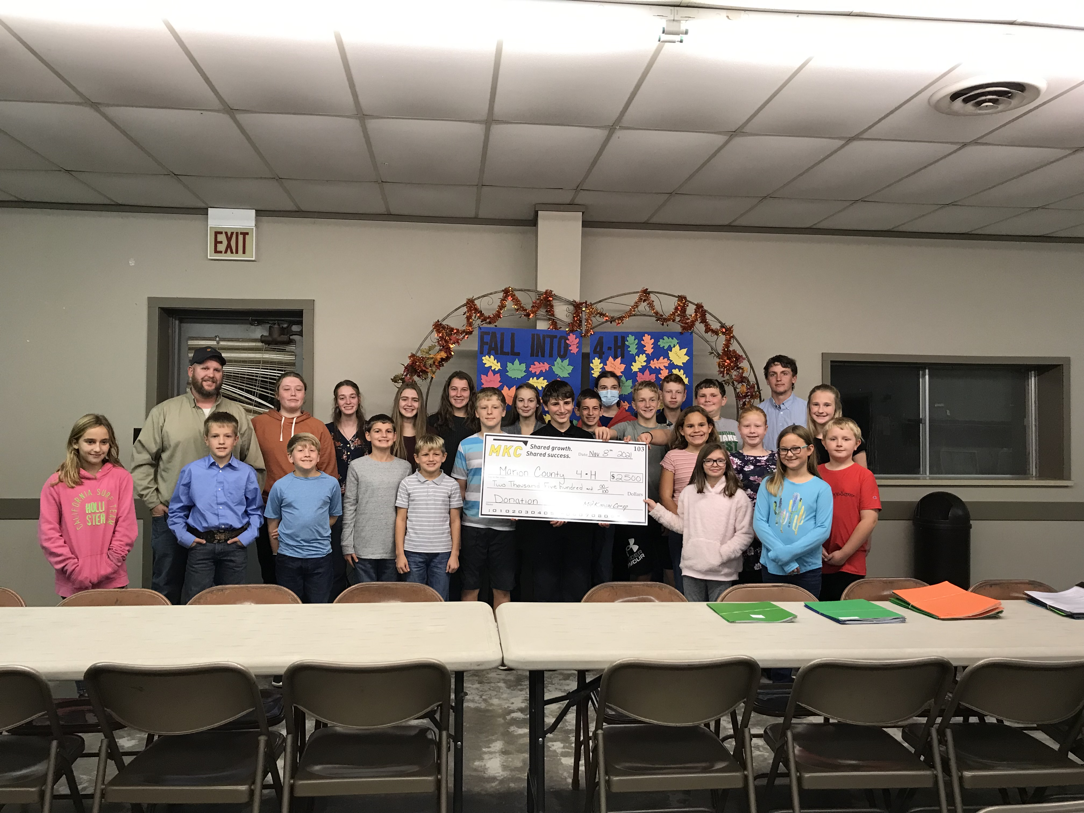
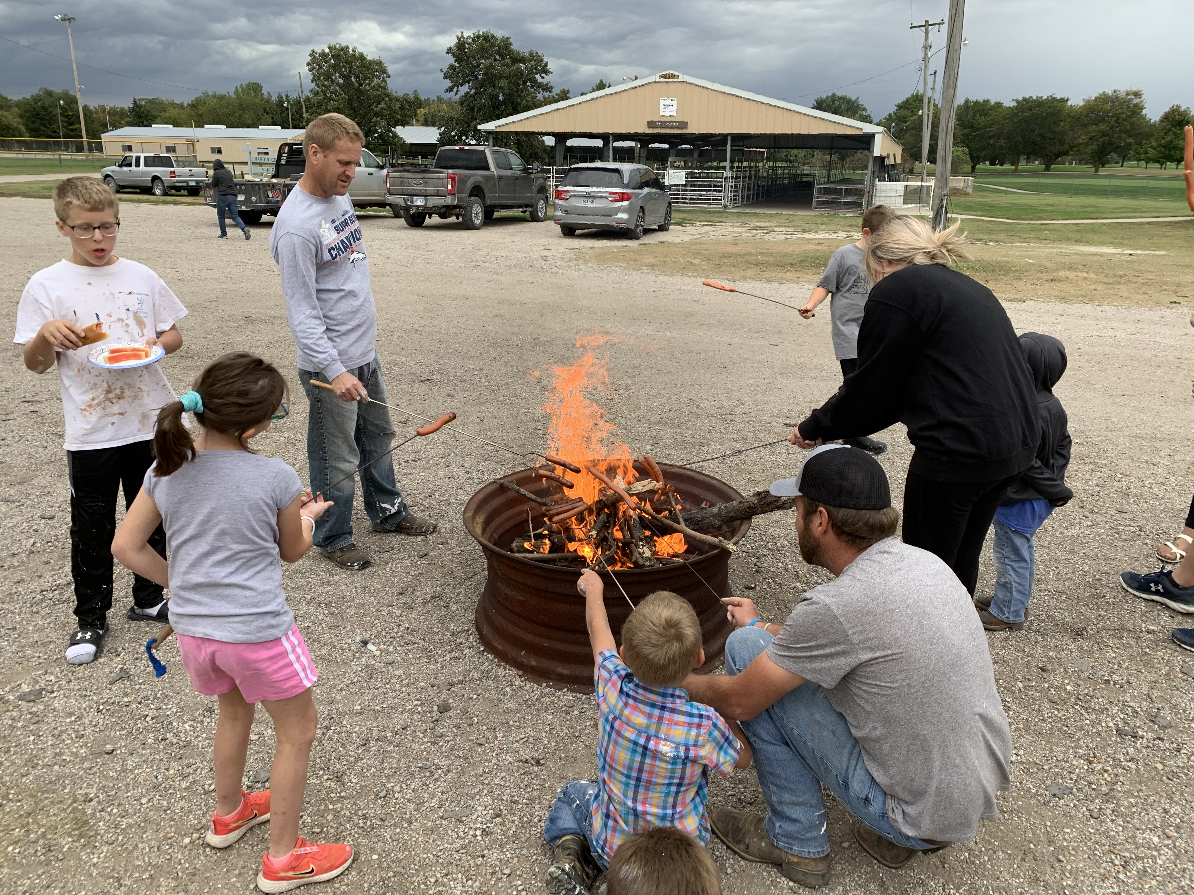
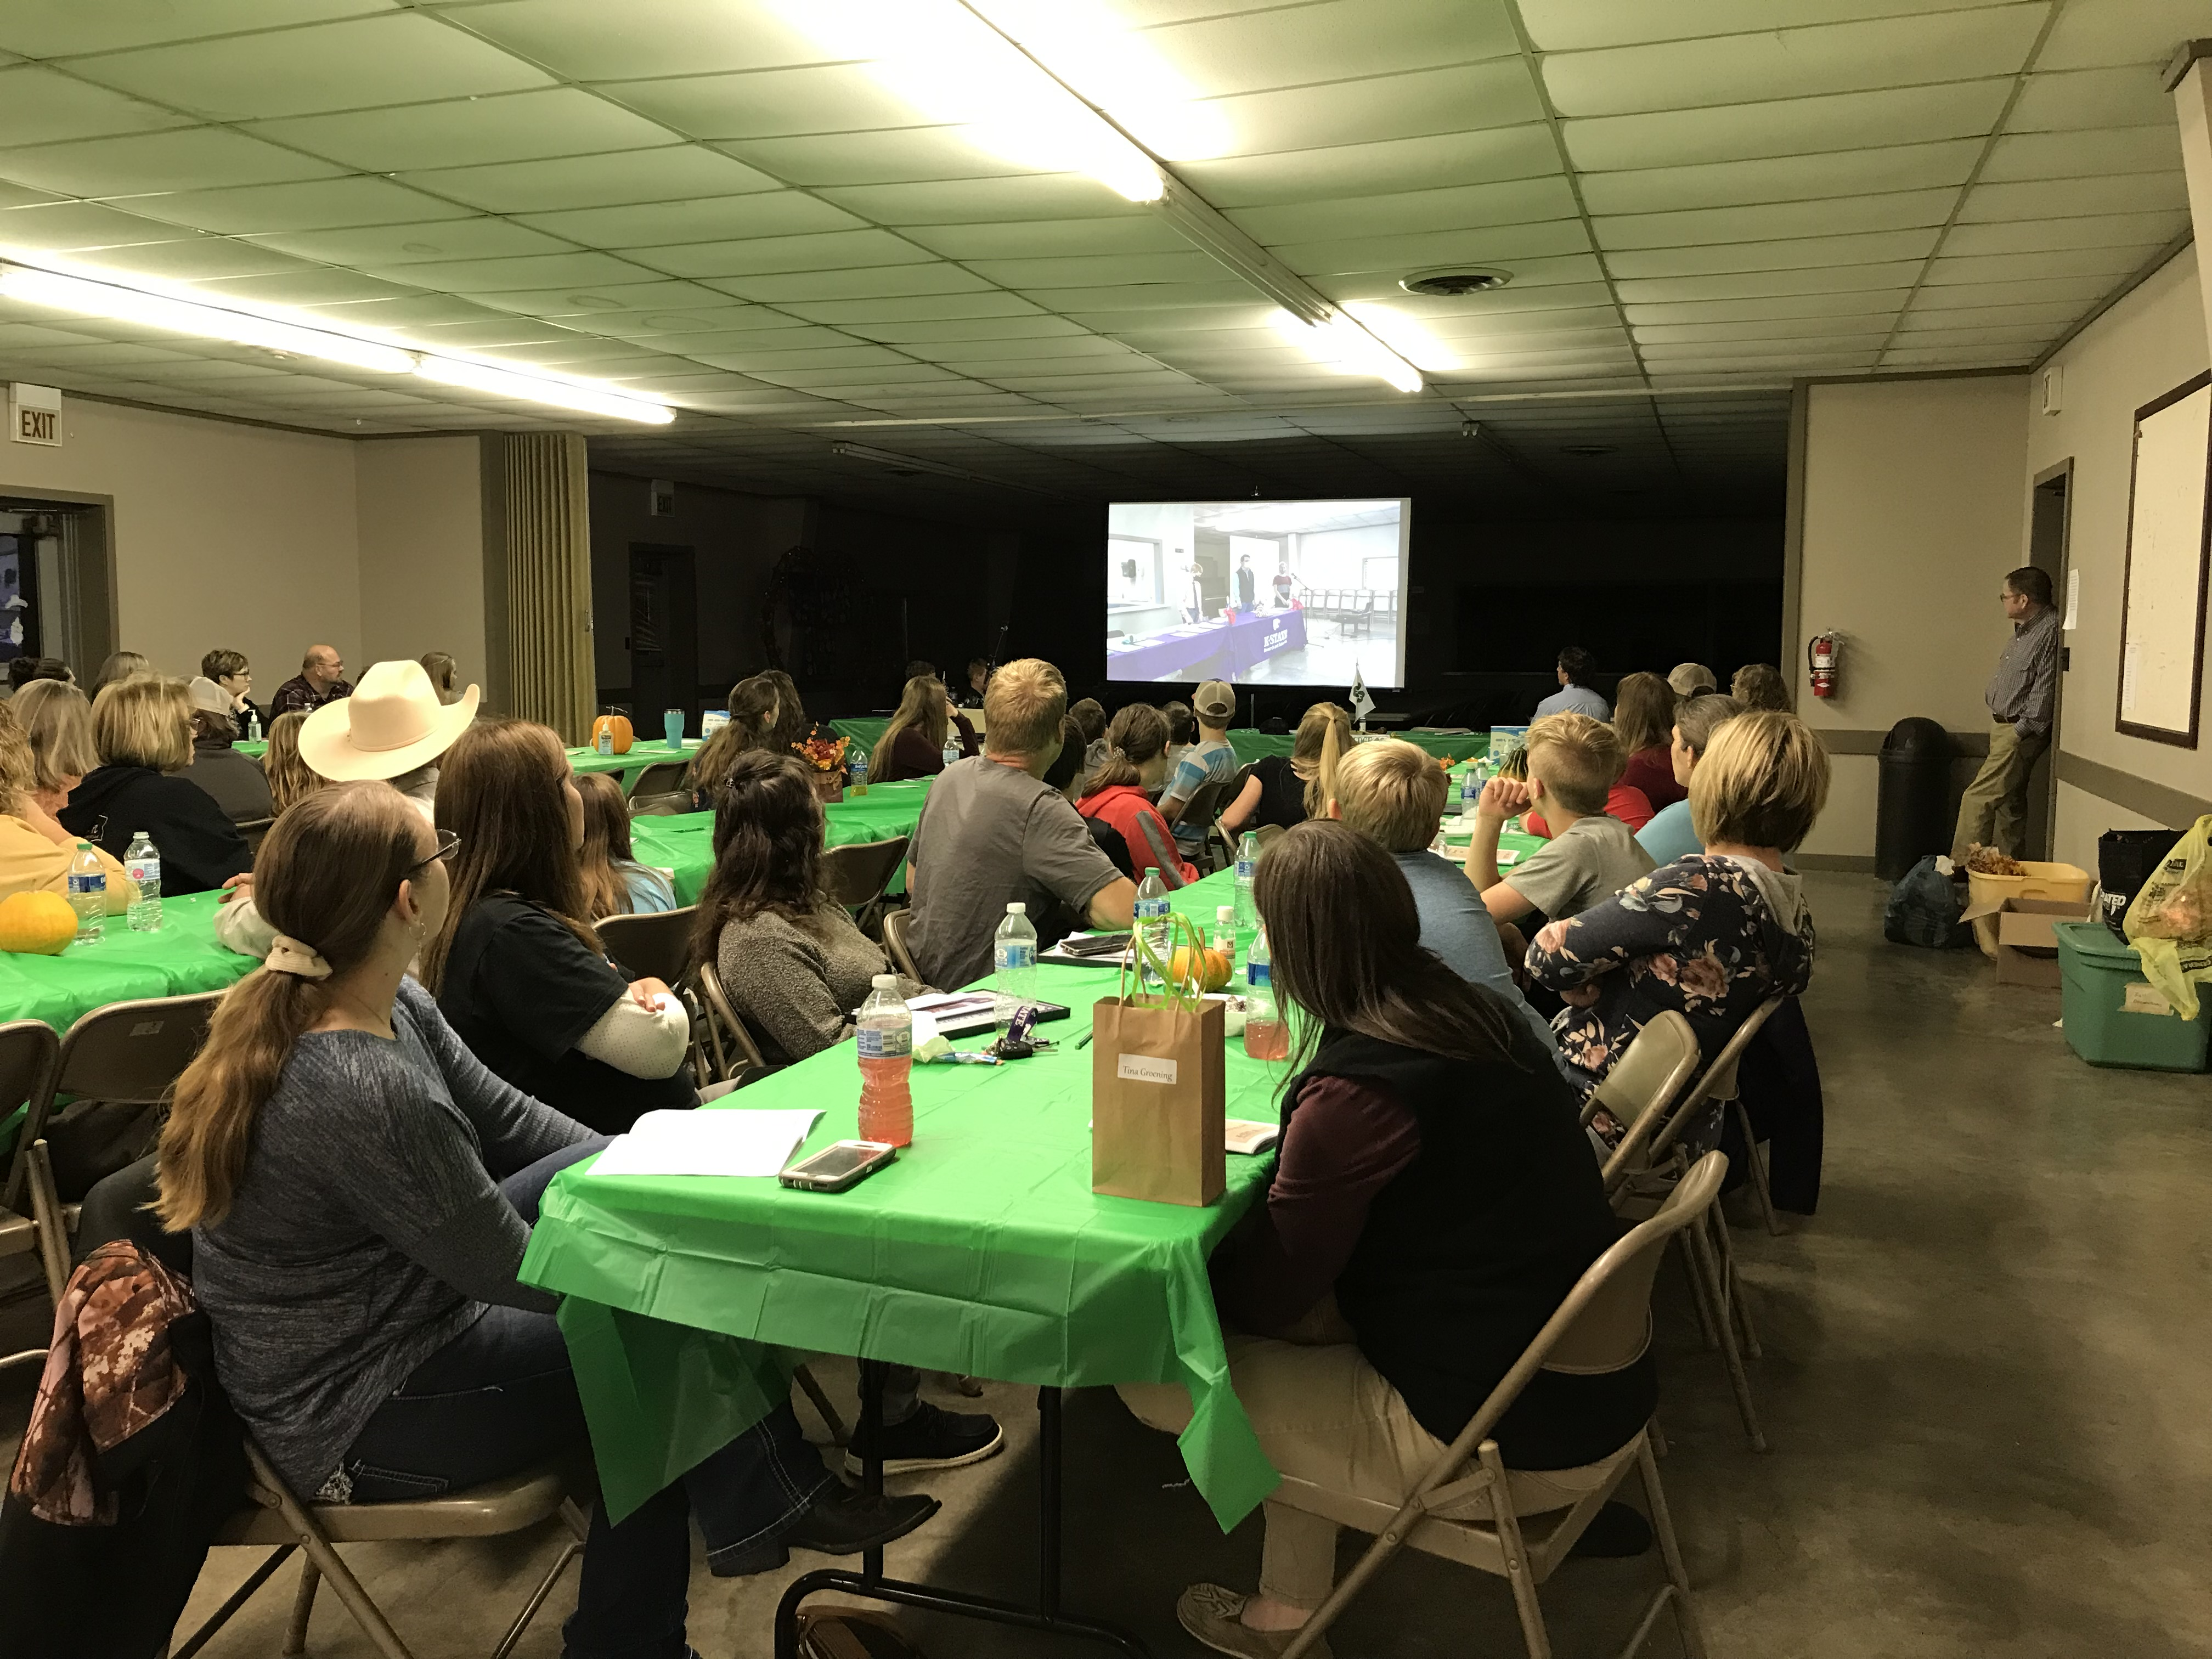
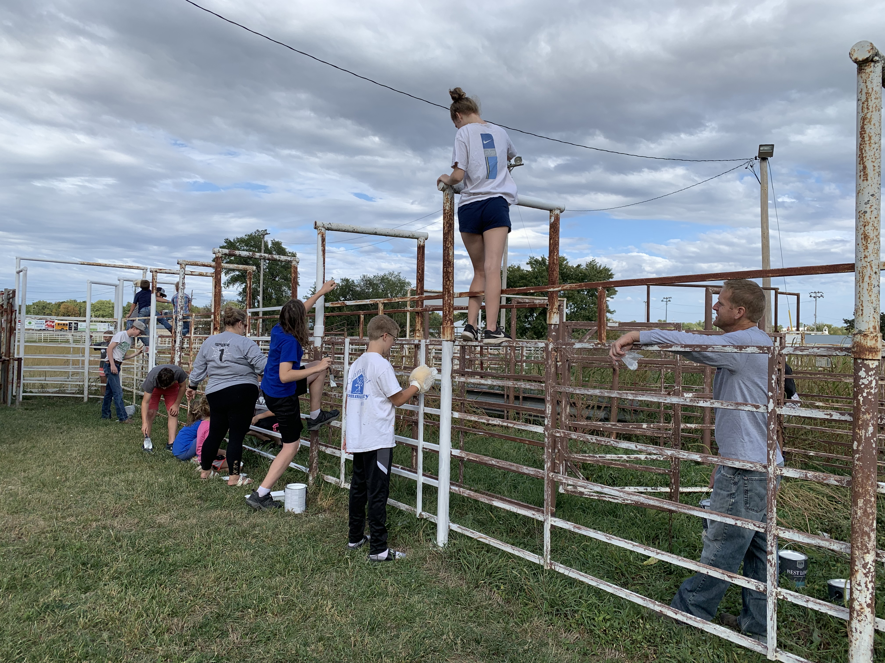
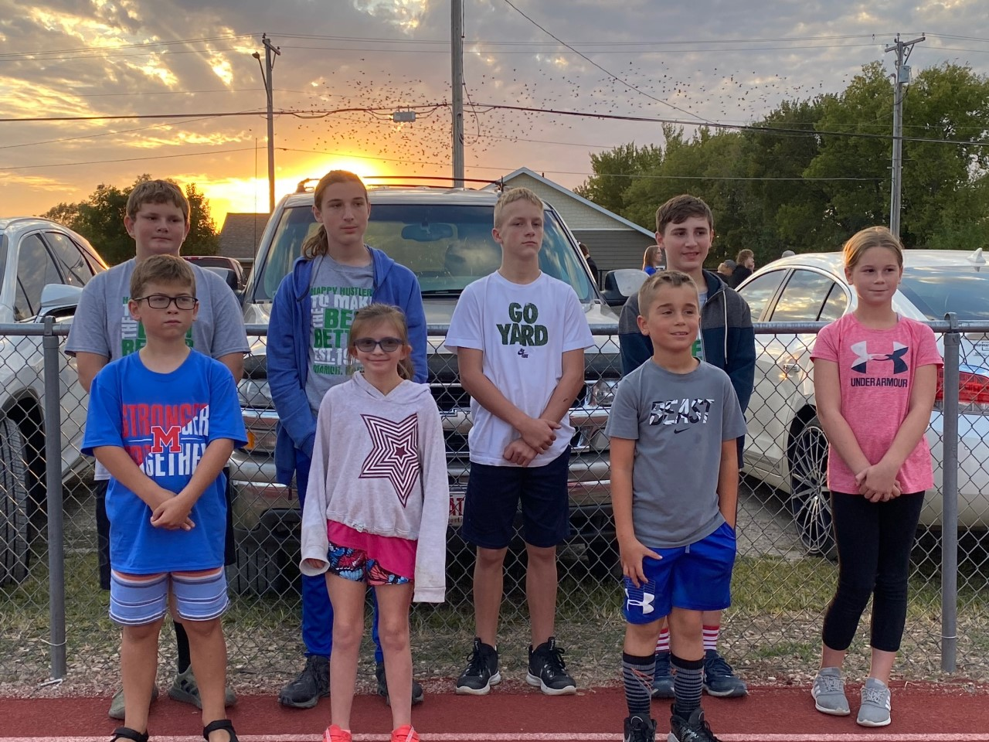
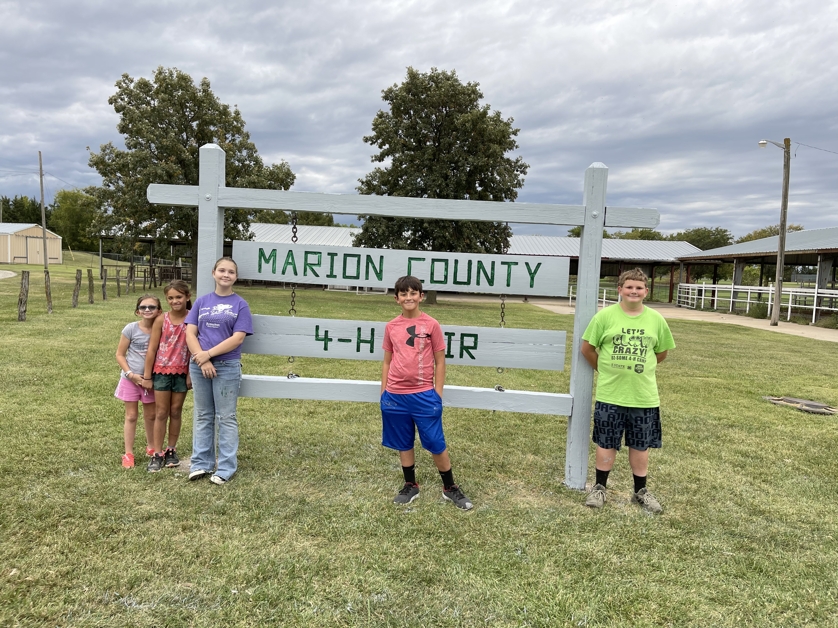
Marion County 4-H Council
March 20, 2022

Slide 2
Agenda
Call to Order
Pledge of Allegiance and 4-H Pledge
Roll Call
Minutes
Communications
Treasurers Report
Committee Reports/Club Reports
Spring Beef Show
Fair Awards
Unfinished Business
New Business
Marion County Fair 2022
Theme
Proposed Schedule
Friends of 4-H Event
Fair Book Updates
4-H Building Renovation Updates
2022 Achievement Banquet Planning Committee

Slide 3
Pledge of Allegiance and 4-H Pledge

Slide 4
Roll Call
What is your favorite 4-H project experience?

Slide 5
Minutes
4-H Council January Meeting Minutes
The meeting of the Marion County 4-H Council was held on Sunday, January 16 at 7:00 p.m. via zoom.
The meeting was called to order by President Ashley Peters. The Pledge of Allegiance and the 4-H Pledge were recited and roll call was answered by 8 youth, 10 adults, 1 guest and Extension Agents Tristen Cope and Ricky Roberts. Roll call was taken by verbally responding to the question “What is the name of a pet you have?”
The October minutes were read by Secretary Karsen Kroupa. Minutes were approved as read with a motion to accept by Noah Schmidt and seconded by Daniel Rziha.
Communications: Lindsey Buechman, a 4-H member of the Willowdale Club in Dickinson County, thanked the 4-H Council for a donation she received to assist with travel expenses to the National 4-H Congress, which was held on November 26-30, 2021. She presented information regarding leadership skills learned at Congress, shared community service projects completed in Atlanta, and encouraged any 4-H member who qualifies at the national level to attend in the future. She also mentioned that a highlight of her trip was touring downtown Atlanta and a Coca-Cola factory.
4-H Council also received two donations from Orsted. Orsted is a business associated with a wind farm project that is currently being developed near Peabody. A $ 500 donation was given to Council (is to be spent as Council sees fit) and a $ 5,000 donation was given to the Endowment Fund (is to be spent on improvements for the Public Announcement system at the Fairground). Orstead would like to meet with the 4H Council in the future to present information about how they can help 4-H clubs through different educational projects regarding STEM learning.

Slide 6
Minutes Cont’d…
The financial report was presented by Treasurer Noah Schmidt. The 4H Council October 1, 2021 balance was $ 10,506.43. Income of $ 1821.24 was received, expenses of $ 612.00 were incurred, which left the balance of $ 11,715.67 on December 31, 2021. Noah broke down balances by category as part of the financial report; a motion to approve was made by Kimberly Kroupa and a second by Noah.
Committee Reports were presented as follows:
There were no committee reports presented; however, committee sign-ups were shared with participants. It is important to note that 4-H Council Committee are limited to council members only. Club leaders should encourage club members to sign-up to serve on Council committees.
Unfinished (Old) business was discussed as follows:
A financial review was completed by the Happy Hustlers 4-H Club. Other clubs in our county need to try to get this done as soon as possible. A financial review is necessary to ensure that we are properly accounting for club finances and documenting income/expenses.
Charlie Peters resigned his post as 4-H Council Vice-President on January 12, 2022. The Council will need to elect a new vice president. The following were nominated: Eli Boden, Olivia Carlson, Alex Young, Sara Groening, and Riley Thomas. Eli and Olivia declined the nominations. Daniel made the motion that nominations cease; Noah seconded. A vote was held among members and Alex Young was elected to serve as the 4-H Council Vice President.

Slide 7
Minutes Cont’d…
New Business was discussed as follows:
Club Day will be held on Saturday, February 12. 2022 in Abilene. Registration needs to be completed by January 20. Some concerns were presented regarding the location. Tristen shared that the intention in the future is to alternate locations between Dickinson and Marion County. Top Purples will go on to compete at Regional Club Day which will be held on March 26 in Clay Center.
Flint Hills Counterpoint, a group encouraging interest in the arts, will be hosting a “Make and Take” art class for youth artists on February 19, 2022 at the Marion County Lake Hall. Participants will make a tote bag inspired by farm animals. There is no cost to attend and 4-Hers are encouraged to check out this opportunity. Flint Hills Counterpoint is also hosting a Baby Farm Animal tour on March 5. The group would like for 4-H Clubs/Participants to consider donating snacks, set up photo booths, present project talks, etc. Any club or participant interested in assisting should contact Tristan for more information.
Scholarship Deadlines are quickly approaching, more information can be found on the state Chisholm Trail 4-H websites.
The Spring Beef Show will be held on April 1, 2022. Registration is available on the Chisholm Trail website.
The Dickinson County 4-H basketball tournament will be held on Saturday, March 12, 2022. Teams must register by Jan. 20 and information can be found on the Chisholm Trail webpage.
A reminder was provided for clubs to continue to work to mitigate the spread of Co-Vid 19 and new variants. Clubs should still be considering social distancing, proper sanitation, and providing zoom options to join meetings.
The next 4-H Council Meeting will be held on Sunday, March 20 at 7:00 p.m.
A motion to adjourn was made by Noah and Karsen seconded.

Slide 8
Communications
Club Report Out!!
What is something your Club has done this Spring?!
Notes:
Lindsey is a 10-year member of the Willowdale Club in Dickinson County, which is now part of the Chisholm Trail District. Lindsey has been selected as a Kansas Representative for National 4H Congress and is seeking donations to assist with the expenses of the trip.

Slide 9
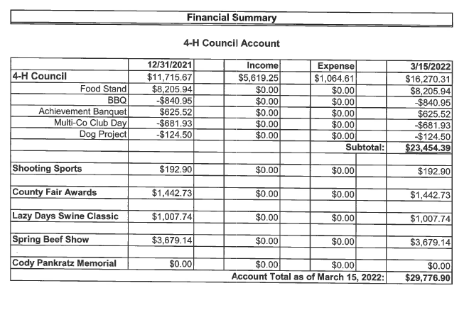
Treasurer’s Report

Slide 10
Committee Reports
Spring Beef Show
Fair Awards

Slide 11
Unfinished Business
None

Slide 12
New Business
Marion County Fair 2022
Dates: July 16-23, 2022
Theme: Hooves in the Air at the Marion County Fair
Proposed Schedule
Friends of 4-H Event
Fair Book Updates

Slide 13
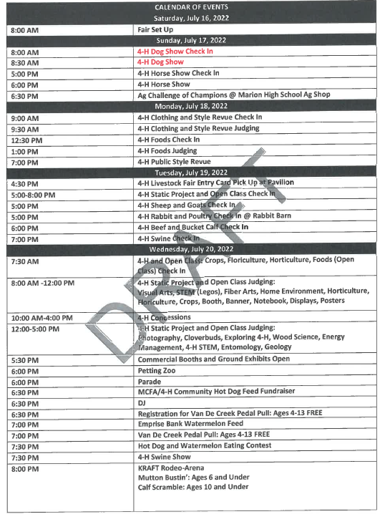
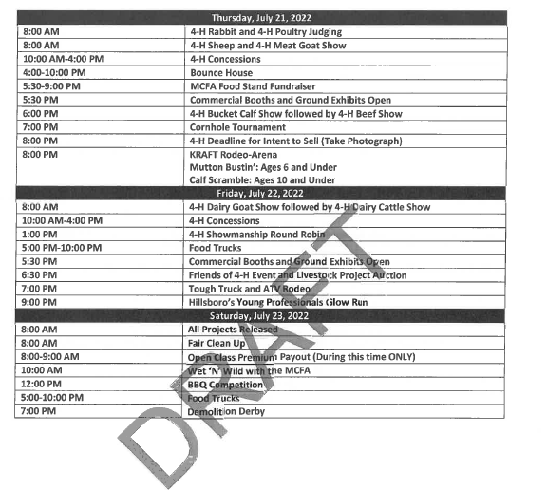
New Business

Slide 14
New Business
4-H Building Renovations Update
2022 Achievement Banquet Planning Committee

Slide 15
Adjourn
Next Meeting Date: May 15, 2022

Slide 16
Upcoming events
Scholarships:
Marion County Deadline: April 1, 2022
https://www.chisholmtrail.k-state.edu/4_h/forms_and_applications/marion_forms_apps/index.html
Konley Harding Scholarship Deadline: May 10, 2022
https://www.flinthills.k-state.edu/4-h/morris-county/scholarships/documents/Timeless%20Application%20Konley%20Harding%20PDF.pdf
Regional 4-H Day:
Date: March 26, 2022 at Clay Center
Spring Beef Show:
Date: March 27, 2022

