Slide 1
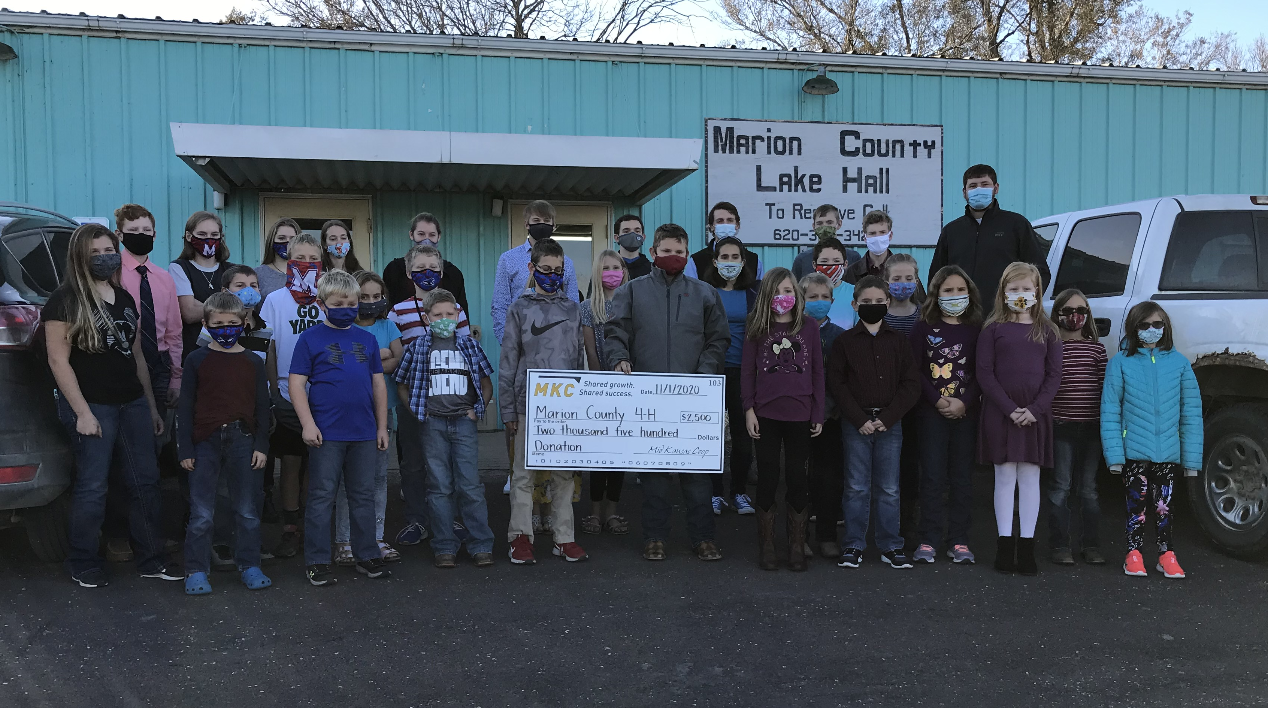
Marion County 4-H Council
January 11, 2021

Slide 2
Agenda
Call to Order
Pledge of Allegiance and 4-H Pledge
Roll Call
Minutes
Communications
Treasurers Report
Committee Reports
Sign Up
Unfinished Business
Financial Review
New Business
Club Day
Fair Dates
NEW Record Books

Slide 3
Pledge of Allegiance and 4-H Pledge

Slide 4
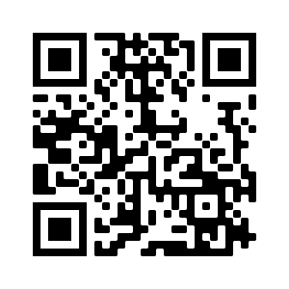
Roll Call
Please Sign-In by filling out the 4-H Council Contact Sheet at the following link: https://forms.gle/4HfmE8az6H9h6Jd4A OR by opening your camera and following the link from the QR Code.

Slide 5
Minutes
4-H Council Meeting Minutes
The Marion County 4-H Council was held on October 2nd, 2020 7:00 p.m. at the Marion County Fairgrounds.
The meeting was called to order. Roll call was answered by _____ attendees, and extension agents Rickey Roberts and Tristen Cope.
The June Minutes were read by ____________. Minutes approved as read.
Communications: State Fair Ribbons are available to pick up after the meeting. Check out the Chisholm Trail Extension District Facebook Page for updates on the 4H Coloring Contest and upcoming Officers Training.
The April Treasurer’s Report: The Treasurers report was read by ___________. ________ reported a beginning balance of $13, 336.02. 4-H Council had an income of $2,640.15 and expenses in the amount of $3,018.06 for a subtotal of $19,976.17. Including Shorting Sports ($330.00 expense), County Fair Awards ($2700.00 income and $2,114.64 expense), Lazy Days Swine Classic ($1,800.00 income and $1,731.85 expense), Spring Beef Show, and the Cody Pankratz Memorial Accounts, 4-H Council has a total balance of $28, 710.41. ______ Motioned to approve the treasurers report. _______ Seconded. Treasurers report approved as read.
Committee Reports: Please let your representatives know to sign up for a committee.
Unfinished Business: None.

Slide 6
Minutes Cont’d…
New Business:
Achievement Night: Date will be November 1, 2020 at the Marion County Lake Hall. Peabody Achievers is in charge of the theme (flyer logo, decorations, photo backdrop).
Kansas Youth Leadership Forum: Date will be November 21-22 in a virtual format.
County-Wide Events: Look over 2020-2021 Calendar
4-H Enrollment Process: This year the State launched 4-H Online 2.0. This will mean a very different enrollment process than before. Tristen will be sending out an email with instructions and a video tutorial in November. The payment will remain the same: $5 4H Council, $5 Endowment Fund, and the remaining $5 can be charged to the clubs or individuals.
Election of Council Officers:
-President: Charlie Peters
-Vice President: Sara Groening
-Secretary: Karsen Kroupa
-Treasurer: Olivia Carlson
______ motions to approve a unanimous ballot. ______ seconds. Motion carries.
Adjournment: _______ moved to adjourn. ________ seconded. Motion carried.
-Minutes Taken By: Tristen Cope (No Secretary Present)
Next Meeting: January 11, 2021

Slide 7
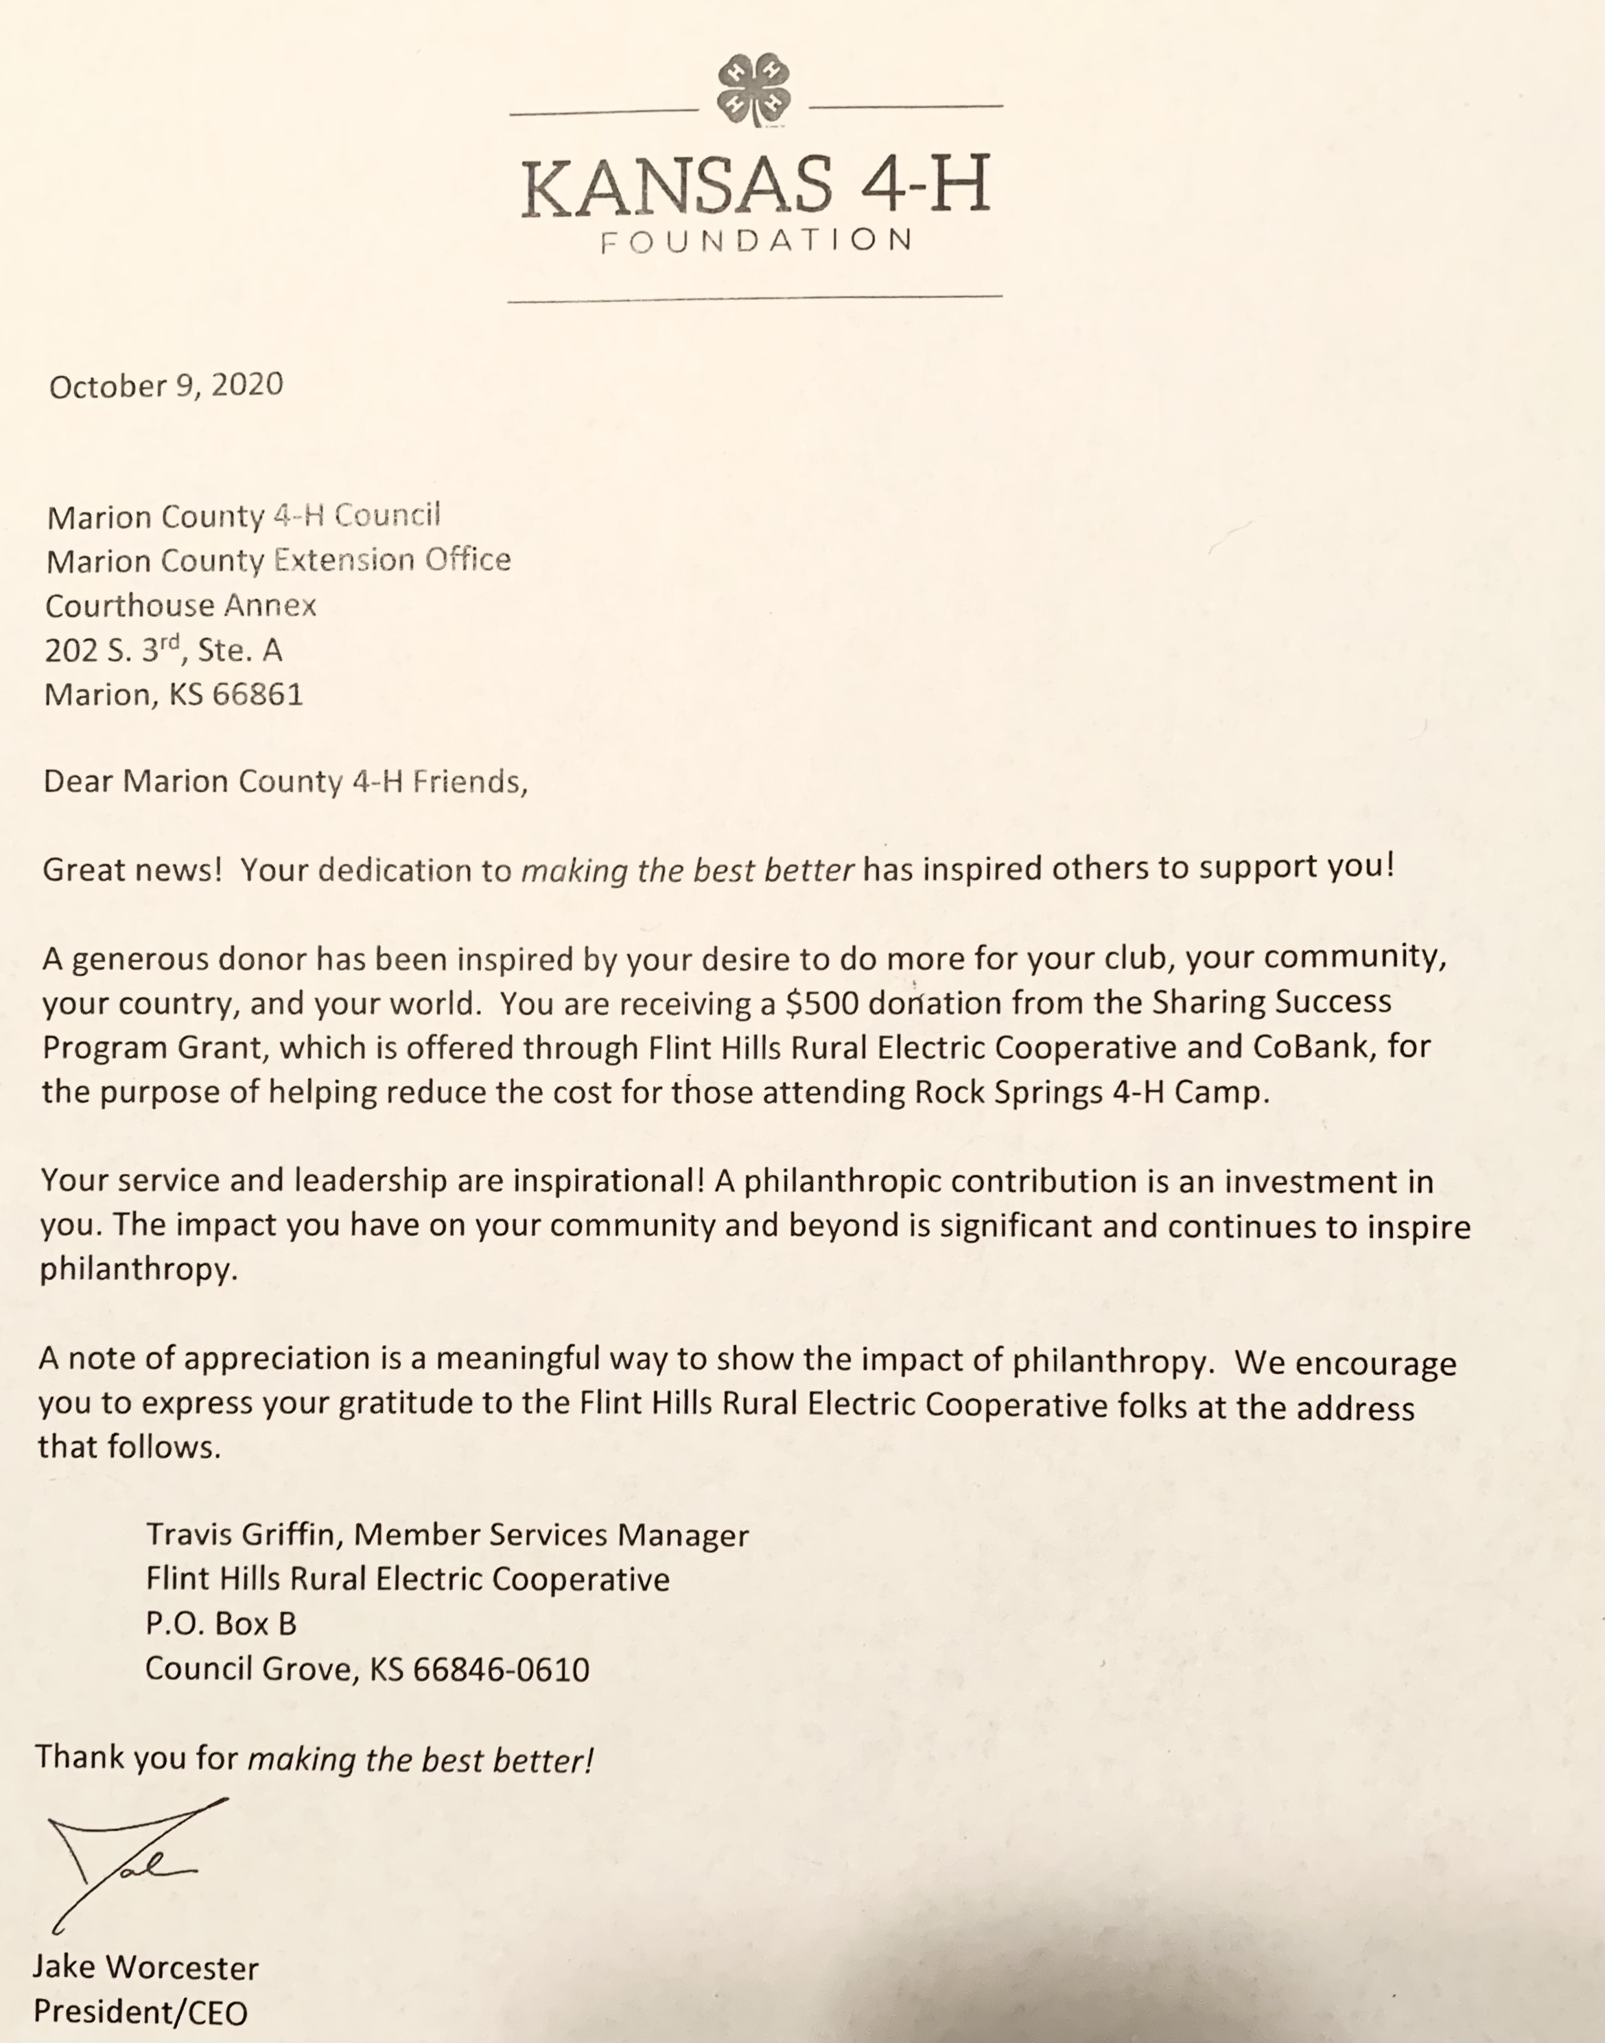
Communications
Chisholm Trail Website
Marion County 4-H Newsletter
Kansas 4-H Foundation

Slide 8
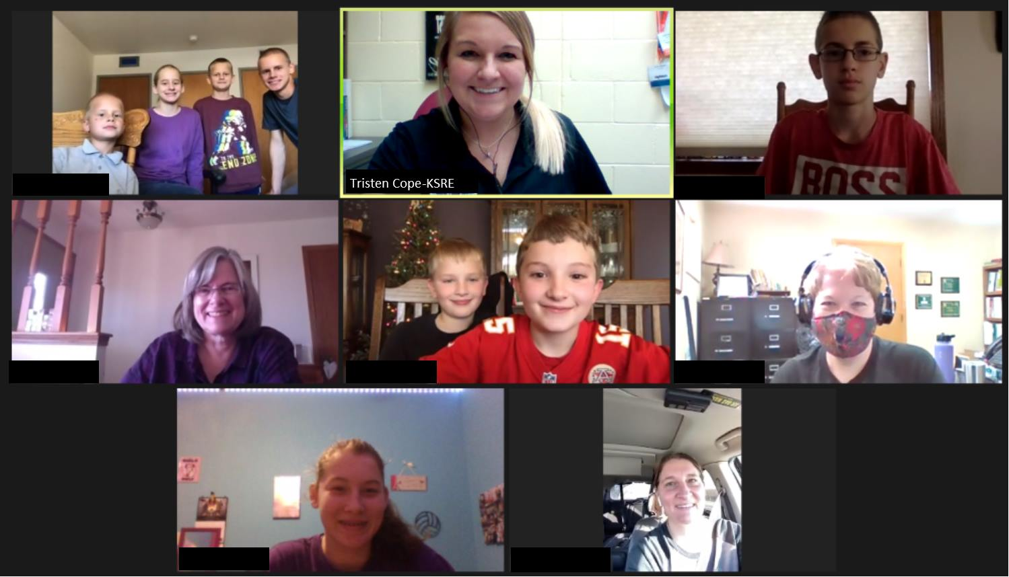
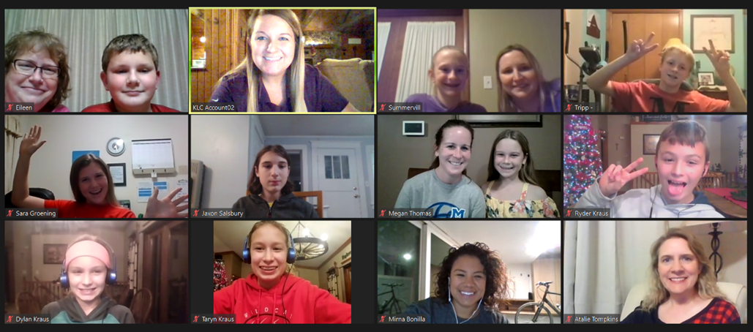
Communications
Kansas Beats the Virus Updates

Slide 9
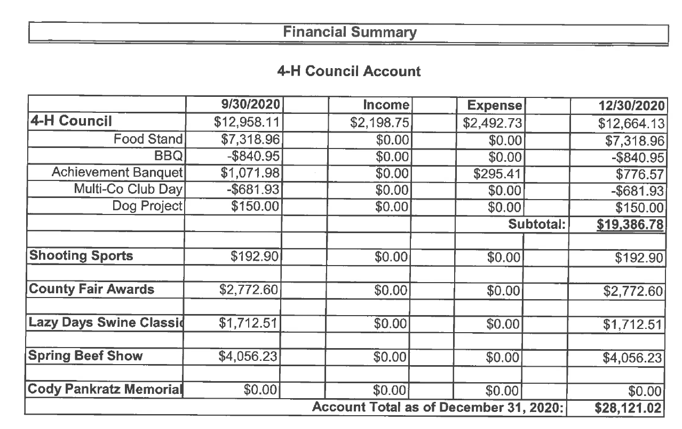
Treasurer’s Report

Slide 10
Committee Reports
Please Sign-In by filling out the 4-H Council Contact Sheet at the following link: https://forms.gle/4HfmE8az6H9h6Jd4A OR by opening your camera and following the link from the QR Code.

Slide 11
Old Business
Financial Review for Club’s

Slide 12
New Business

Slide 13
New Business
Fair Dates: See Calendar on our webpage
Fair Theme: “Fun for the Whole Herd…Take 2!”

Slide 14
New Business
NEW Record Book Process

Slide 15
Adjourn
Next Meeting Date: March 10, 2021

