Slide 1
4-H Committee Meetings
Fair Awards: Meet in Program Room
Style Revue: Meet in Conference Room

Slide 2
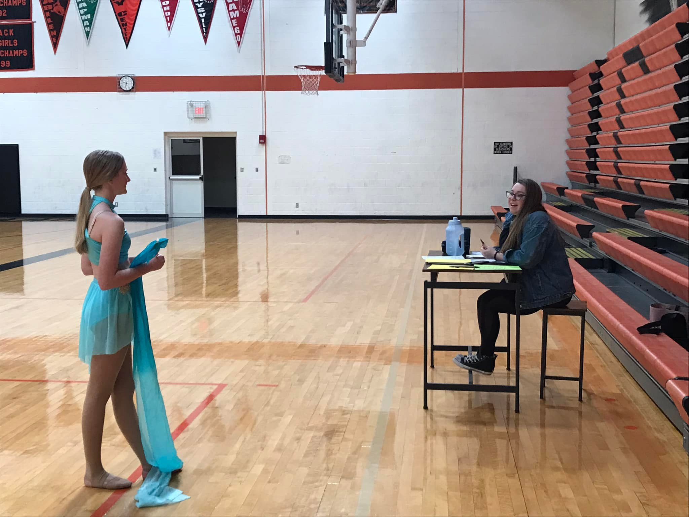
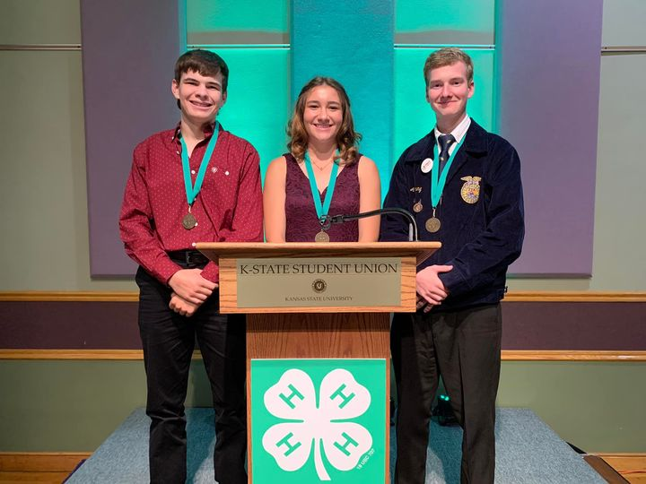
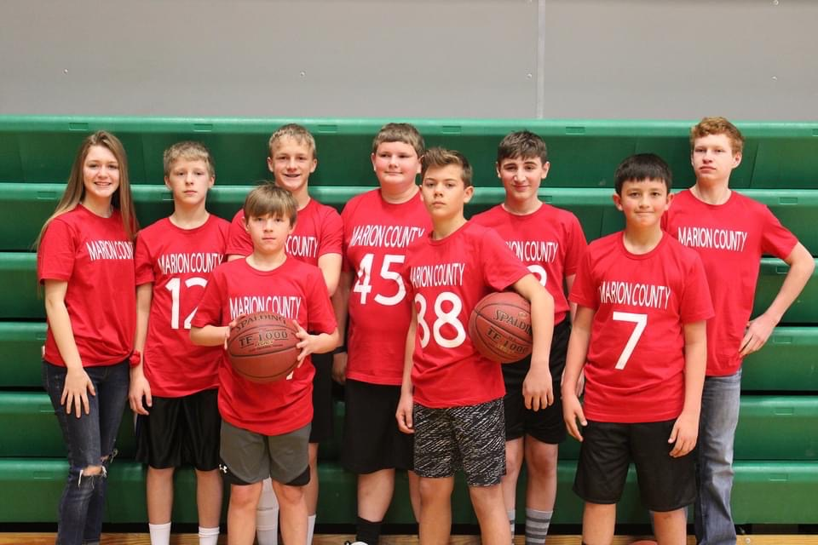
Marion County 4-H Council
February 19, 2023

Slide 3
Agenda
Call to Order
Pledge of Allegiance and 4-H Pledge
Roll Call
Minutes
Communications/Club Reports
Treasurers Report
Committee Reports
Spring Beef Show
Fair Awards
Style Revue
Old Business
4-H Council Sponsorship Drive
New Business
Marion County Fair
Theme
Food Stand
Friends of 4-H Meal

Slide 4
Pledge of Allegiance and 4-H Pledge

Slide 5
Roll Call
What is your favorite 4H Event?

Slide 6
Minutes
4-H Council October Meeting Minutes
The meeting of the Marion County 4-H Council was held on Sunday October 9, 2022 at 6:00 p.m. at the Fairgrounds.
The meeting was called to order by President Ashley Peters. The Pledge of Allegiance and 4-H Pledge were recited. Roll call was taken by having those present announce their name and club. Roll call was why did you join 4-H and answered by 8 youth, 6 adults, Extension Agents Ricky Roberts and Tristen Cope.
The June minutes were read by parent/leader Eileen Schmidt. The minutes were approved.
Communications: Each leader was given a box with record books from Dickinson County to Judge. Also there was a check form Marion County Farm Bureau given to each club for National 4-H week. Clubs reported what they are doing. South Cottonwood is going to have their annual Fall Party which consists of bowling. Tampa Triple T’s are going to have a Halloween Party. Peabody Achievers are doing a hot chocolate stand downtown Peabody around Christmas. Goessel Goal Getters are doing a leadership team building and planning their upcoming year activities. Lincolnville Wide Awake club is going to rake leaves for a community member that is 108 and planning their year as well. Happy Hustlers is going to have a hayrack ride.

Slide 7
Minutes Cont’d…
The financial report was presented by Treasurer Noah Schmidt. The 4-H council June 1, 2022 balance was $16,023.52. Income of $1,403.23 was received, expenses of $1,143.51 which left the balance of $16,283.24. We had a subtotal of $22,540.81. The overall account balance is $36,173.05 as of August 31, 2022. The treasurer report was approved and passed.
Committee Reports were reported as follows:
We are needing to get people signed up for the Spring Beef Show, Fair Awards, Style Revue, Lazy Days Swine Show, and 4-H Council Sponsorship Drive. Anyone can sign up for these by going to https://tinyurl.com/MN4HCommittee
Unfinished Business: There was none.

Slide 8
Minutes Cont’d…
New Business:
Approve 2022-2023 County 4-H Calendar: next Council meetings will be January 15, 2023, March 19, 2023, May 8, 2023, and June 19, 2023. It was also brought up that if we could keep from having the Spring Beef Show and District Club day not the same day/weekend. Sounds like district club day will be in February.
4-H Enrollment: Discounted fee from Oct 1st- Dec 1st. Fee will be $15. You can go and enroll at https://v2.4honline.com, re-enrollment steps were listed as well. There is a video tutorial of 4H online. Coupon code was given. The $15.00 goes towards Kansas 4-H fee $5.00 Marion County 4-H Endowment Fund, $5.00 to Marion County 4-H Council, and $5.00 please ask your club leaders about the remaining. Each club will get billed as to how much they will need to write a check to 4-H Council.
District Officer Training will be held Monday October 24, 2022 at Emmanuel Church 1300 N Vine Abilene, KS Registration starts at 6:45 and training starts at 7:00 pm. It is good for club officers, organizational leaders, cloverbud leaders, and new family members. If you are unable to attend officers may choose to complete the scavenger hunt worksheet utilizing our 4-H officer training video, the Chisholm Trail District 4-H webpage and Kansas 4-H. Completed worksheets must be emailed to Megan (mkanguiano@ksu.edu) by December 1 to count toward your club’s seal.

Slide 9
Minutes Cont’d…
Achievement Banquet will be held on Sunday November 6, 2022 at 6:30 at Marion Community Building. The Theme and Decorations will be decided by Lincolnville Wide Awake 4-H club. Dinner the extension office will provide the meal, paper ware, and drinks. Families will provide a side dish. RSVPs will be going out. Tristen will need help setting up chairs and tables either Friday, Saturday, or Sunday. The Carlson family and Bourbon family volunteered. The council voted to do pulled pork for the main portion of the meal. Michelle Hajek moved and Eileen Schmidt seconded the vote. Motion was approved.
Discussion of 4-H Council Sponsorship Drive: This year we are going to do a sponsorship drive instead of individuals or businesses getting hit up multiple times. A flyer/brochure will be given out to clubs and each club will be responsible to talking to business and individuals in their Community. The Sponsorship card will be due back by December 31, 2022. The businesses can decide when they want to get billed and how many times. We also suggested we get a list of donors so thank yous can be wrote and also get a window cling for them to hang or put in their windows.
Election of 4-H Council Officers: 2022-2023 new 4-H Council Officers were elected
President Alex Young
Vice President Ashley Peters
Secretary Olivia Carlson
Treasurer Rylee Thomas
Next meeting will be January 15, 2023 at the Marion County Extension Office.
Athena Funk moved that we adjourn and Noah Schmidt seconded the motion. Motion passed.
Minutes taken by Eileen Schmidt

Slide 10
Communications
Club Report Out!!
What is something your Club is planning for this Spring?
Notes:
Lindsey is a 10-year member of the Willowdale Club in Dickinson County, which is now part of the Chisholm Trail District. Lindsey has been selected as a Kansas Representative for National 4H Congress and is seeking donations to assist with the expenses of the trip.

Slide 11
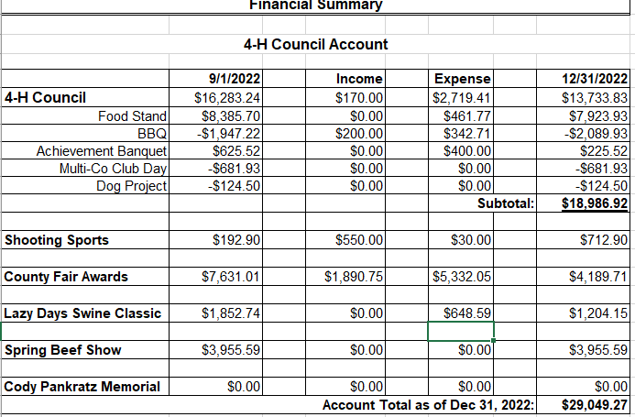
Treasurer’s Report

Slide 12
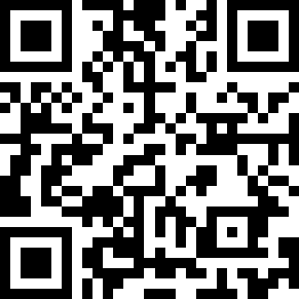
Committee Reports
Spring Beef Show
Fair Awards
Style Revue
Lazy Days Swine Show
Sign Up: https://tinyurl.com/MN4HCommittee

Slide 13
Unfinished Business
4H Council Sponsorship Drive
2022 Total Donations for All Events (Spring Beef Show, Fair Awards, Lazy Days Swine Show): $8,370.00
2023 Received from Drive: $4,375.00

Slide 14
New Business
Marion County Fair
Date: July 15th-22nd
Theme: Stirrups of Fun

Slide 15
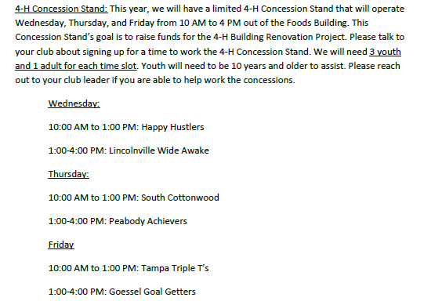
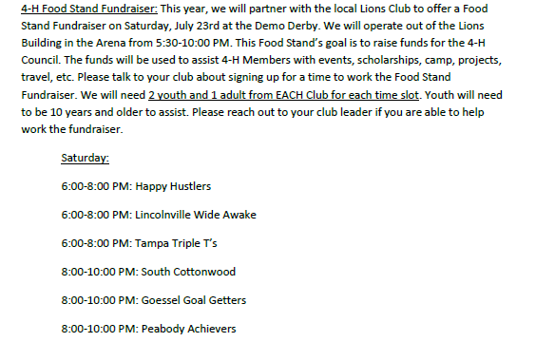
New Business
Marion County Fair: Food Stand 2022
2022: Loss of $112.10 and District cost of $1,500 for Food Stand Manager
2023: Same as 2022?
New ask for Wed Evening from 5-9 PM
*Was Closed Wed.

Slide 16
New Business
Marion County Fair: Friends of 4-H Meal
2022 Cost $1,448.98
Meal Donations: $200.00
Sams Club Order for Meal

Slide 17
Upcoming events
District Officer Training:
Marion County Deadline: April 1, 2023
https://www.chisholmtrail.k-state.edu/4_h/forms_and_applications/marion_forms_apps/index.html
Konley Harding Scholarship Deadline: May 2023
https://www.flinthills.k-state.edu/4-h/morris-county/scholarships/documents/Timeless%20Application%20Konley%20Harding%20PDF.pdf
Regional 4-H Day:
Date: March 25, 2023 at Clay Center
Spring Beef Show:
Date: March 26, 2023

Slide 18
Adjourn
Next Meeting Date: March 19, 2023

